Slide 1
Generative Adversarial Networks (GANs)
From Ian Goodfellow et al.
A short tutorial by :-
Binglin, Shashank & Bhargav

Slide 2
Outline
Part 1: Introduction to GANs
Part 2: Some challenges with GANs
Part 3: Applications of GANs

Slide 3
Part 1
Motivation for Generative Models
From Adversarial Training to GANs
GAN’s Architecture
GAN’s objective
DCGANs

Slide 4
GANs
Generative
  Learn a generative model
Adversarial
  Trained in an adversarial setting
Networks
  Use Deep Neural Networks
Notes:
GAN is an acronym for Generative Adversarial Networks.
-- Where, the Generative part refers to the fact that GANs are Generative models
-- The Adversarial part refers to the fact that GANs are trained in an adversarial manner
-- And the Networks part refers to the fact that GANs use Deep Neural Nets.
Now, we’ll look at the Generative and Adversarial components in detail …

Slide 5
Why Generative Models?
We’ve only seen discriminative models so far
  Given an image X, predict a label Y
  Estimates P(Y|X)
Discriminative models have several key limitations
  Can’t model P(X), i.e. the probability of seeing a certain image
  Thus, can’t sample from P(X), i.e. can’t generate new images
Generative models (in general) cope with all of above
  Can model P(X)
  Can generate new images
Notes:
So, what are Generative models and why do they matter
-- Until now, we have only seen Discriminative models in class
-- I.e. We were given an image and the task was to label the image as a whole or some parts of it.
-- I.e. if X is your image, and Y is the label, we were essentially estimating the distribution P(Y|X)
-- And we saw many architectures CNNs, RNNs that are very good at such tasks.
So, discriminative models have several advantages
-- We get to estimate less number of parameters in a supervised learning setting
-- Give us useful latent representations that we can use across tasks, for instance as we saw in the earlier lectures, we can use the output activations of an intermediate layer of VGGNet as a dense representation of an image.

Slide 6
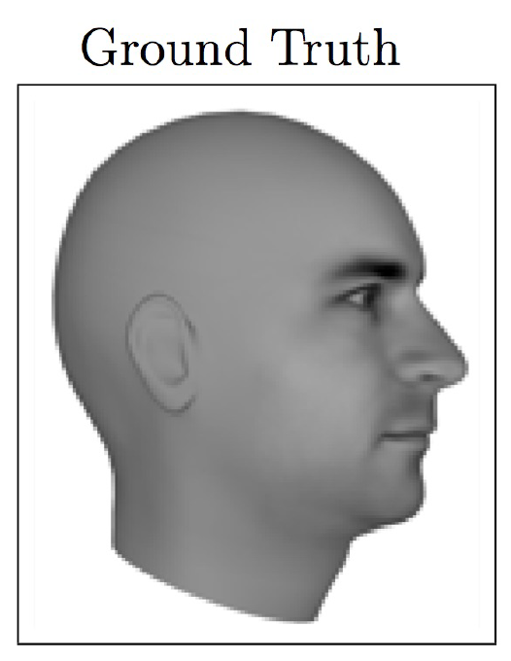
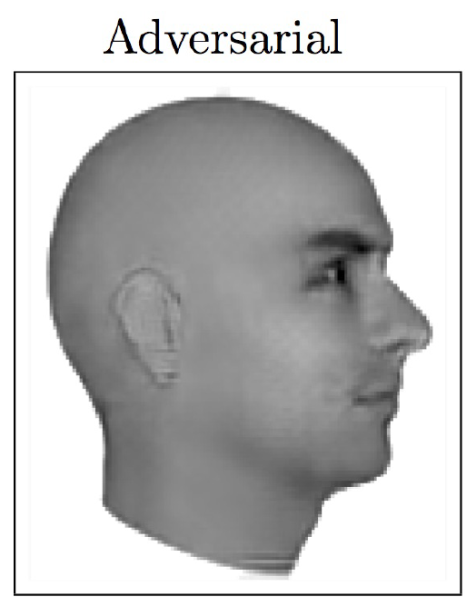
Magic of GANs…
Notes:
-- Now, let’s look at some cool things that you can do with GANs
-- [Next Video Frame Prediction]

Slide 7
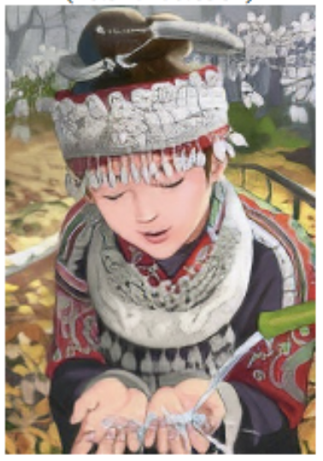
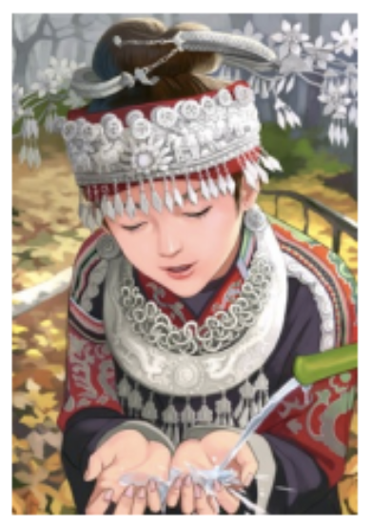
Magic of GANs…
Which one is Computer generated?
Notes:
Right one is the original image

Slide 8
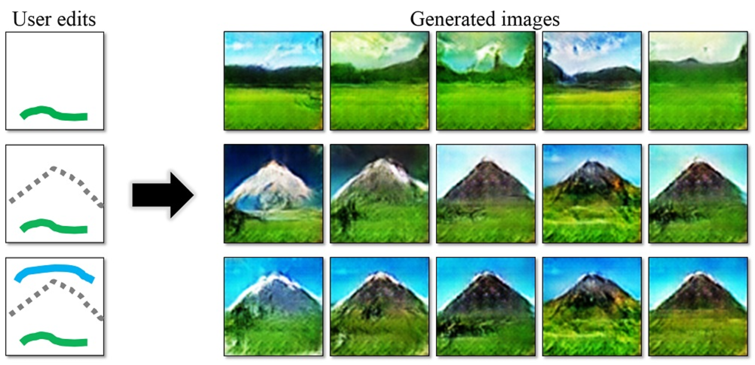
Magic of GANs…
Notes:
-- Draw strokes and the network generates images for you.

Slide 9
Adversarial Training
In the last lecture, we saw:
  We can generate adversarial samples to fool a discriminative model
  We can use those adversarial samples to make models robust
  We then require more effort to generate adversarial samples
  Repeat this and we get better discriminative model
GANs extend that idea to generative models:
  Generator: generate fake samples, tries to fool the Discriminator
  Discriminator: tries to distinguish between real and fake samples
  Train them against each other
  Repeat this and we get better Generator and Discriminator
Notes:
[..]

Slide 10
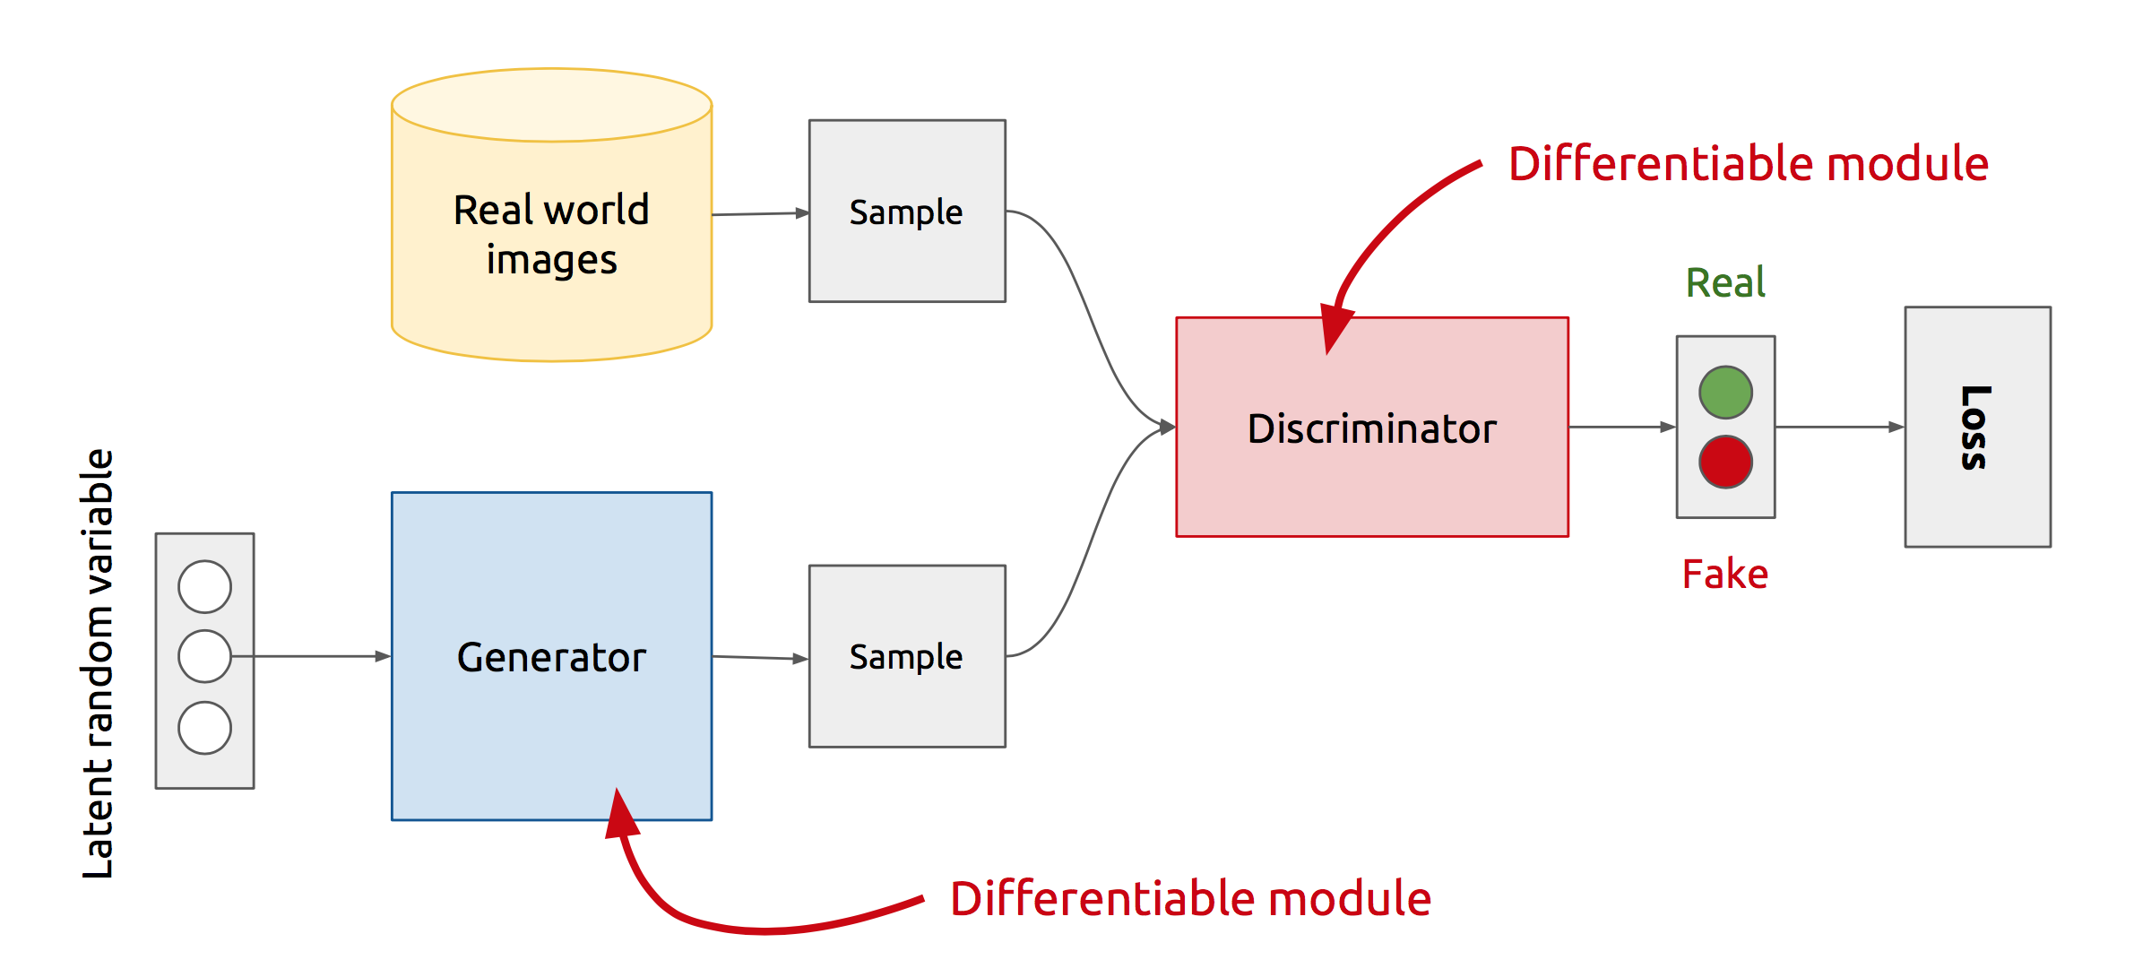
GAN’s Architecture
x
D
D(x)
G
z
G(z)
D(G(z))
Z is some random noise (Gaussian/Uniform).
Z can be thought as the latent representation of the image.
Notes:
Let’s look at the real GAN architecture now :-
-- We have two networks here Generator and Discriminator
-- Discriminator gets input from both the Generator and Real training samples and predicts which one is real and which one is fake.
-- The way Generator generates fake images is .. It randomly samples a noise z, passes it through its network, and the output of the network gives us the image.
-- So, the rationale with that will be that z is sort of your latent representation for the image.. And you generate the image from your latent representation by passing it through
the generator network.
Never directly see true samples.

Slide 11
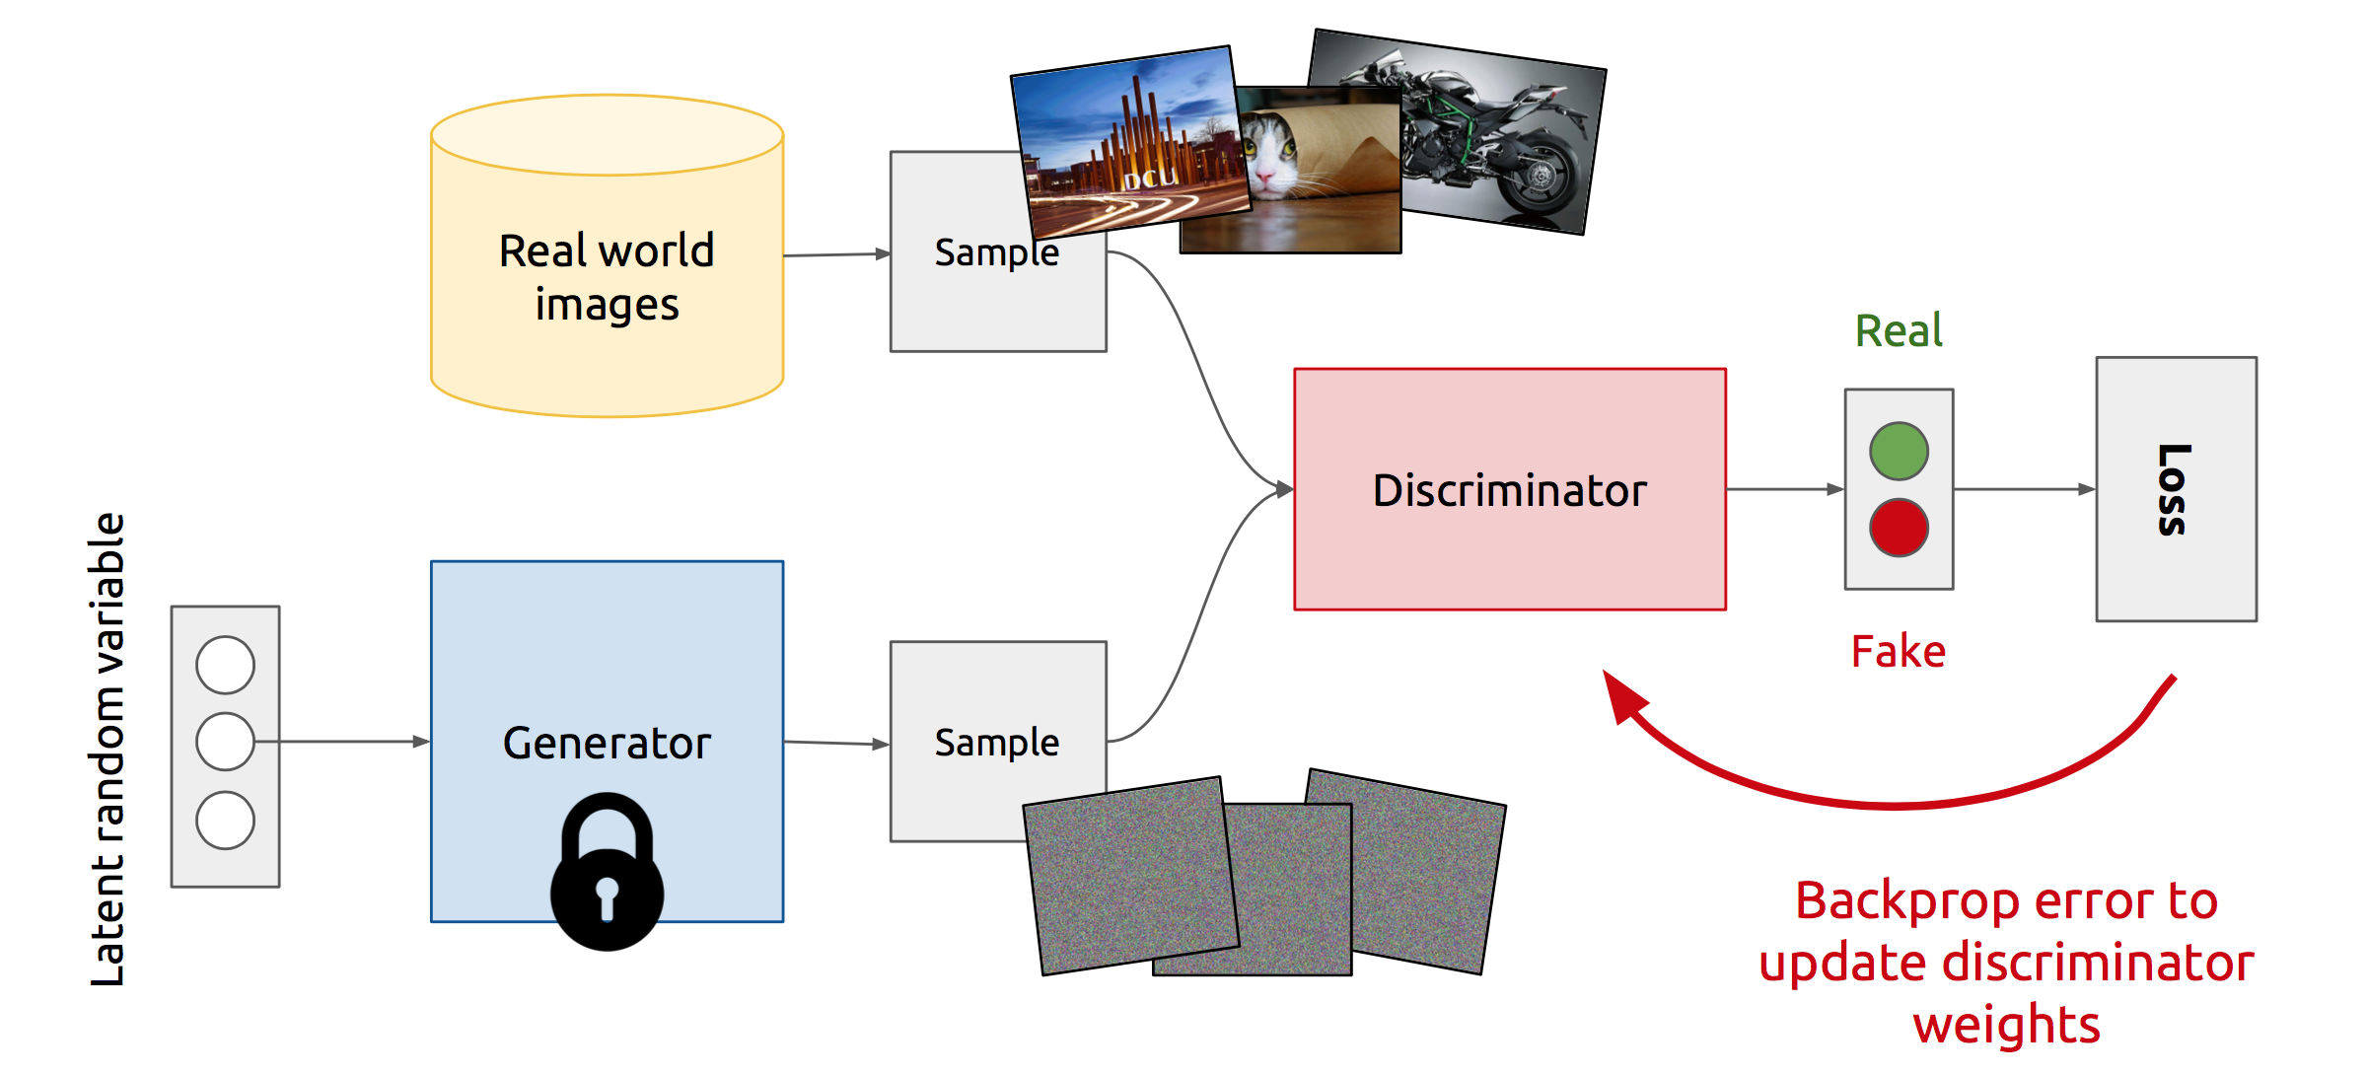
Training Discriminator
Notes:
So, this is how GANs operate :-
At the start of the iteration, a true example is selected and passed through the discriminator. The discriminator outputs the probability of it being a real example, calculate its loss, and update its weights while keeping the generator weights as constant.

Slide 12
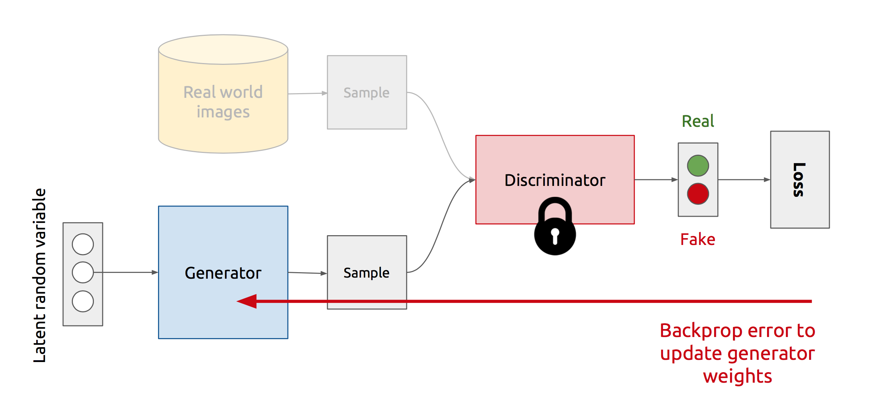
Training Generator
Notes:
Now :-
Generator selects a random noise z, passes it through the generator network to generate a fake image, and then passes it through the discriminator network to output the probability of it being fake. It then calculates its loss, and update its weights while keeping the discriminator’s weights as constant
And we repeat this process of Alternate updates.
Act as complicated loss function.

Slide 13
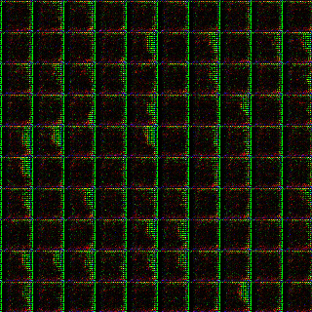
Generator in action
Notes:
However, when trained on CIFAR dataset, the quality of images is not that good..
One can argue that it is easy to generate faces as compared to different classes of objects
So, this wasn’t so inspiring.. Then came the first GAN architecture that did a great job at generating high quality images .. DCGAN

Slide 14
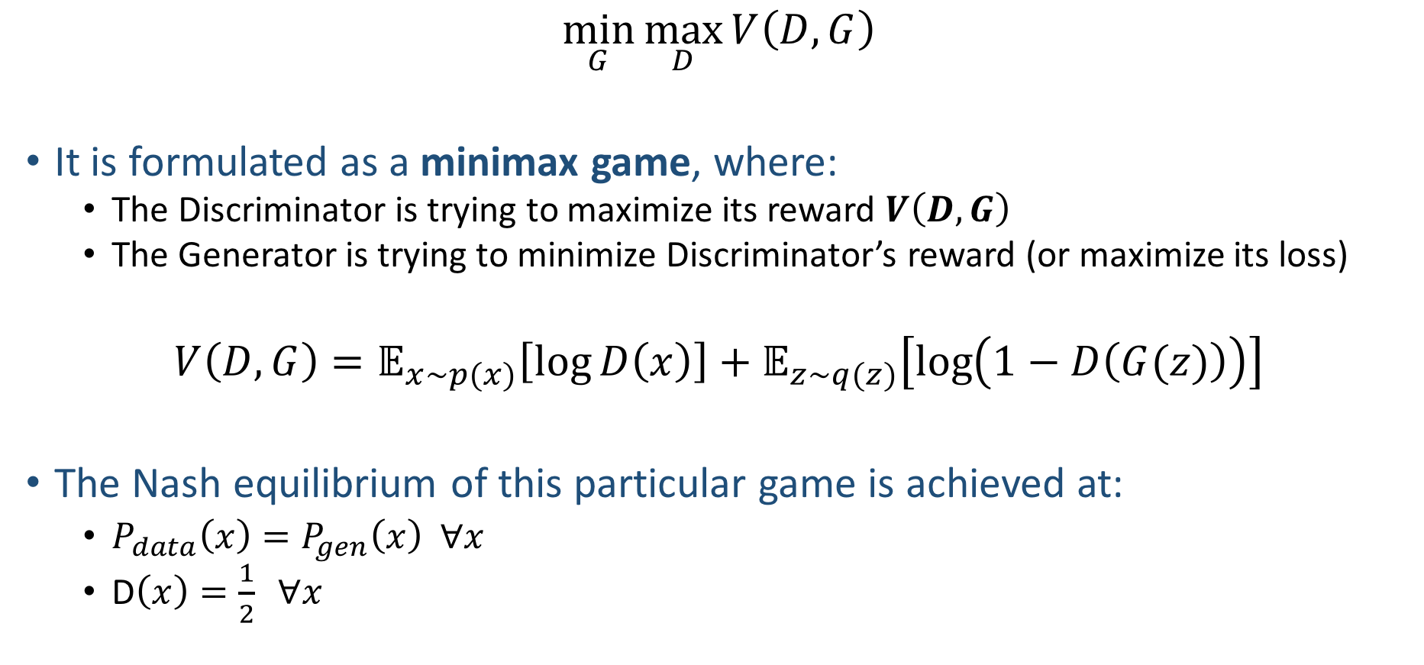
GAN’s formulation
$$\min_{G}{\max_{D}{V\left(D, G\right)}}$$
It is formulated as a minimax game, where:
  The Discriminator is trying to maximize its reward $V\left(D, G\right)$
  The Generator is trying to minimize Discriminator’s reward (or maximize its loss)
$$V\left(D, G\right)=𝔼_{x∼p(x)}\left[\log{D\left(x\right)}\right]+𝔼_{z∼q(z)}\left[\log\left(1−D\left(G(z)\right)\right)\right]$$
The Nash equilibrium of this particular game is achieved at:
  $P_{data}\left(x\right)=P_{gen}\left(x\right) ∀x$
  D$\left(x\right)=\frac{1}{2} ∀x$
Notes:
So, the idea is pretty straightforward, but the real smart thing about GANs is how they formulate their objective.
They formulate it as a [..]
i.e. Basically for fixed generator’s parameters, you maximize Discriminator’s reward, and then you fix Discriminator’s parameters and minimize Discriminator’s reward with respect to Generator’s parameters, and repeat.
[..]
D(x) should be 1 for real examples
0 for fake examples

Slide 15
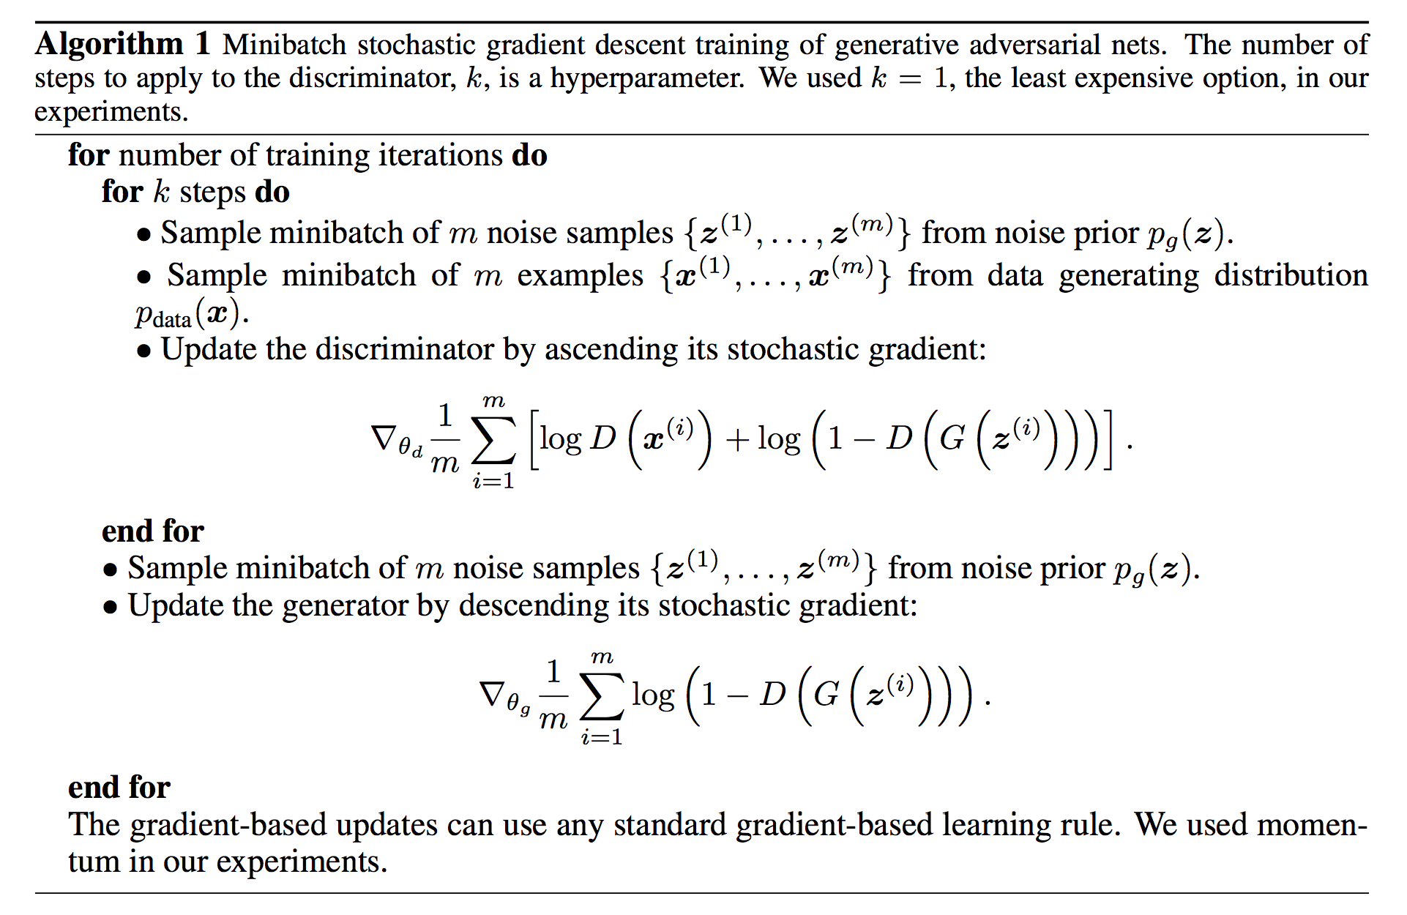
Discriminator updates
Generator updates
Notes:
So combining all these ideas, let’s quickly look at the algorithm more formally that I had explained earlier

Slide 16
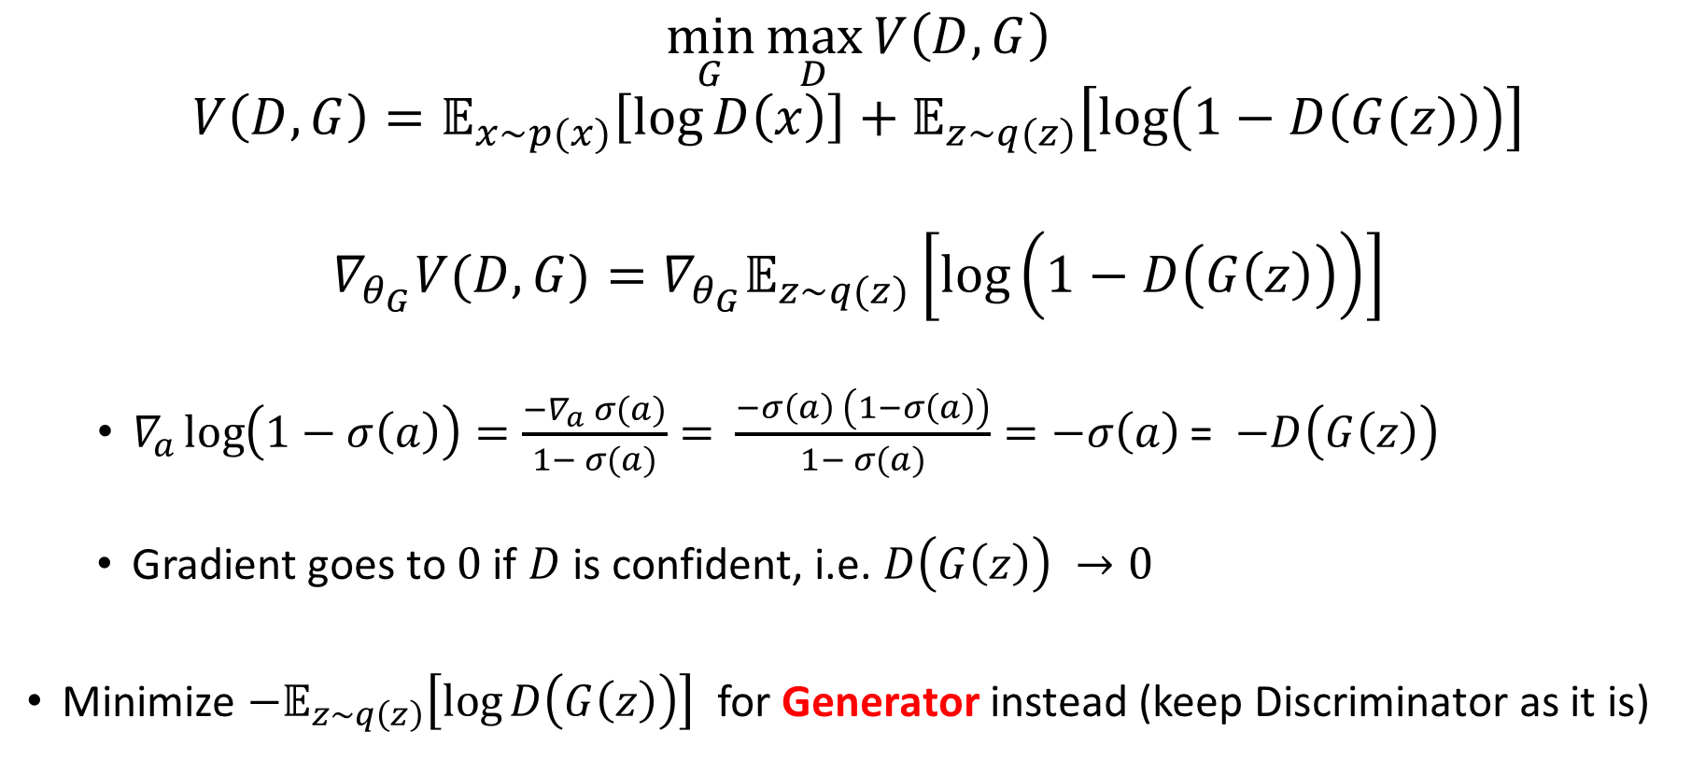
Vanishing gradient strikes back again…
$$\min_{G}{\max_{D}{V\left(D, G\right)}}$$
$$V\left(D, G\right)=𝔼_{x∼p(x)}\left[\log{D\left(x\right)}\right]+𝔼_{z∼q(z)}\left[\log\left(1−D\left(G(z)\right)\right)\right]$$
$$∇_{θ_{G}}V(D,G)=∇_{θ_{G}}𝔼_{z\sim q(z)}\left[\log\left(1−D\left(G\left(z\right)\right)\right)\right]$$
  $∇_{a}\log\left(1−σ\left(a\right)\right)=\frac{−∇_{a} σ(a)}{1− σ(a)}=$ $\frac{−σ\left(a\right) \left(1−σ\left(a\right)\right)}{1− σ(a)}=−σ\left(a\right)$ = $−D\left(G\left(z\right)\right)$
  Gradient goes to $0$ if $D$ is confident, i.e. $D\left(G\left(z\right)\right) →0$
Minimize $−𝔼_{z\sim q\left(z\right)}\left[\log{D\left(G\left(z\right)\right)}\right]$ for Generator instead (keep Discriminator as it is)
Notes:
Ask the class to figure out the problem with the formulation
[..]
The new formulation has the same optimal point as the old one, but doesn’t suffer from the vanishing gradients problem
However, with the new modified loss, you can’t compactly write down the formulation as a zero-sum min-max game
a is the output before sigmoid

Slide 17
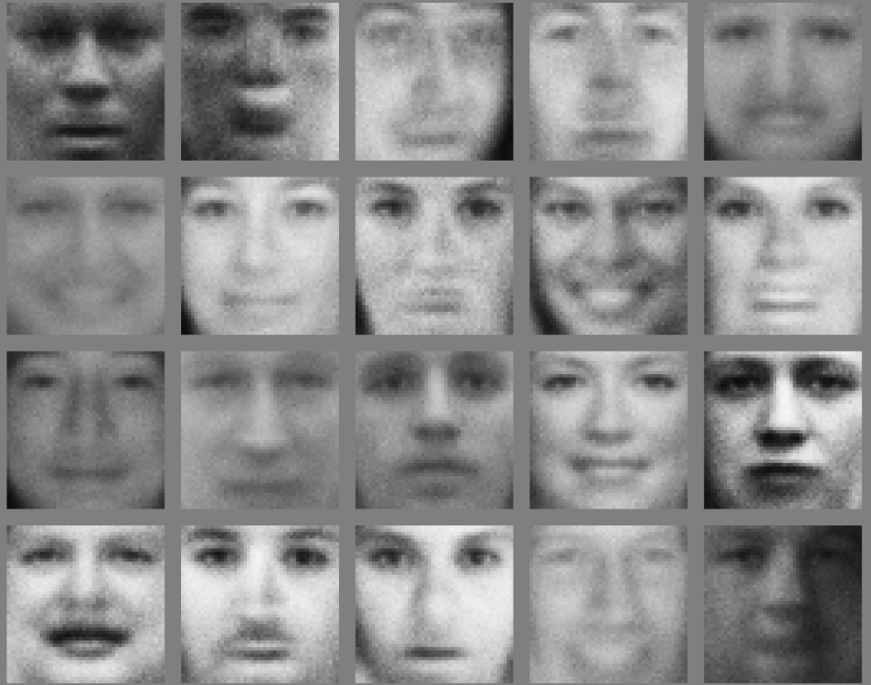
Faces
Notes:
So Vanilla GAN produces decent looking Faces

Slide 18
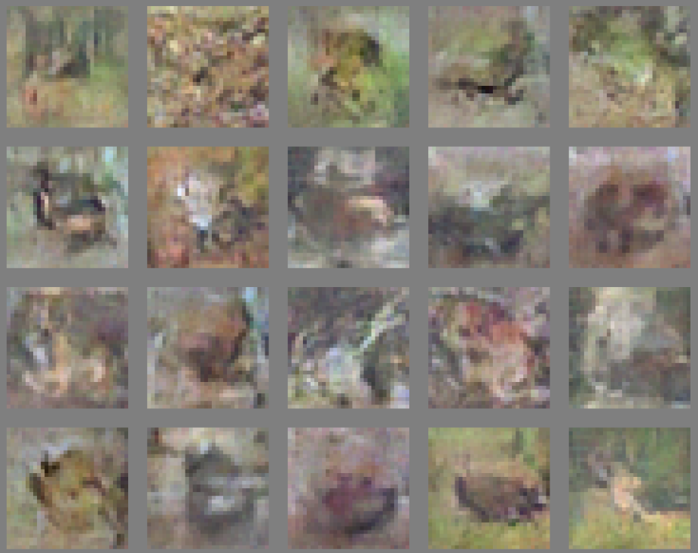
CIFAR
Notes:
However, when trained on CIFAR dataset, the quality of images is not that good..
One can argue that it is easy to generate faces as compared to different classes of objects
So, this wasn’t so inspiring.. Then came the first GAN architecture that did a great job at generating high quality images .. DCGAN

Slide 19
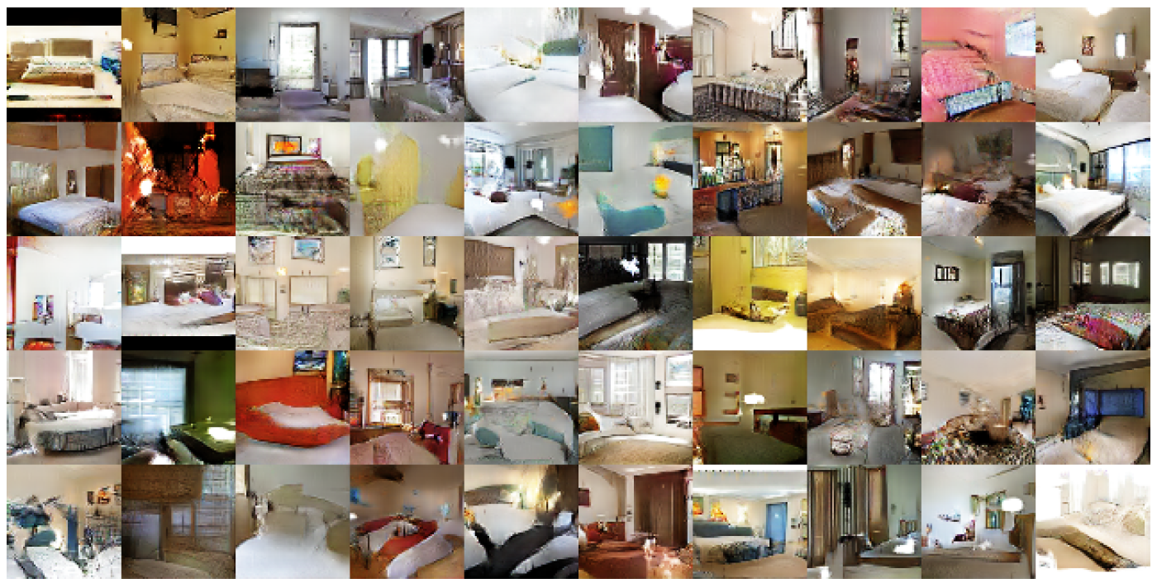
DCGAN: Bedroom images
Notes:
For instance, with DCGAN you can generate such nice looking bedroom images .. Since these are low resolution, zooming it up will pixelate it, so we won’t zoom on a single image

Slide 20
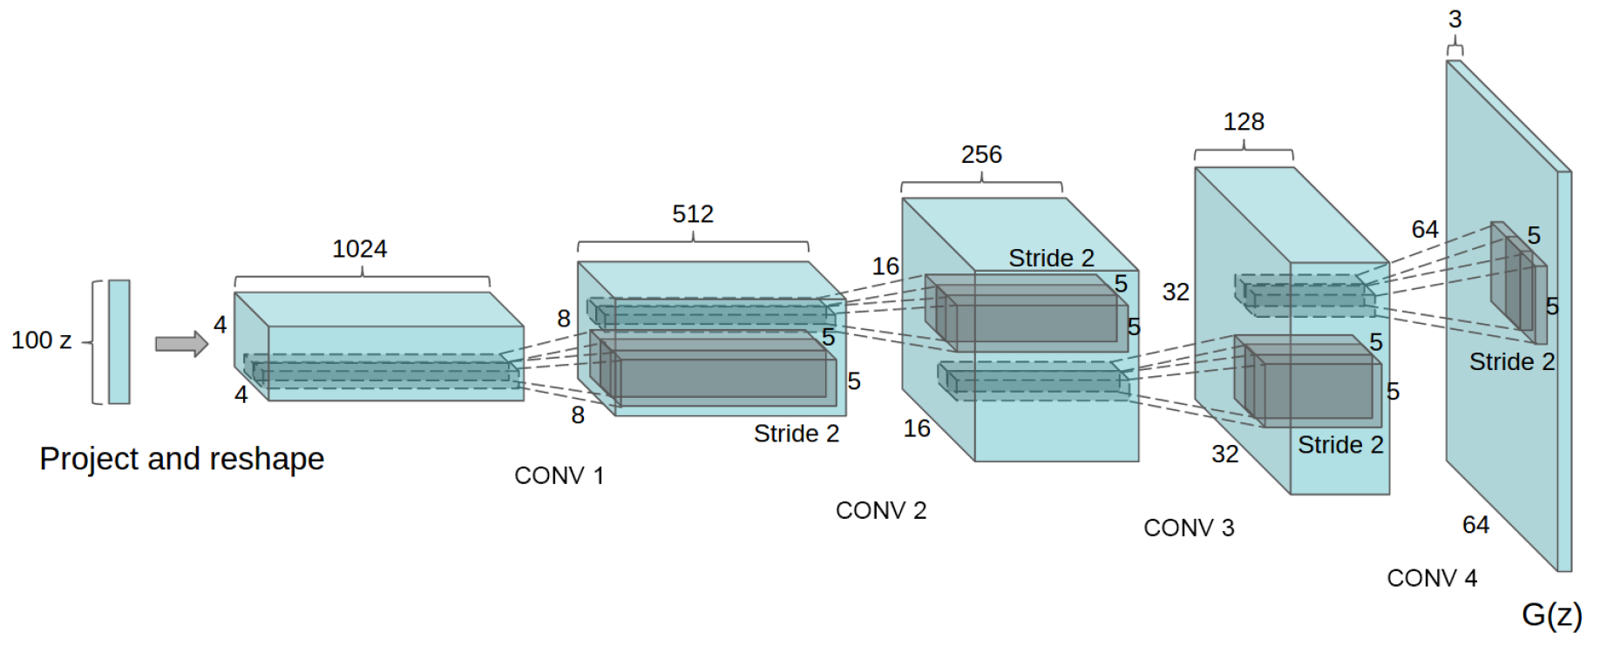
Deep Convolutional GANs (DCGANs)
Key ideas:
Replace FC hidden layers with Convolutions
  Generator: Fractional-Strided convolutions
Use Batch Normalization after each layer
Inside Generator
  Use ReLU for hidden layers
  Use Tanh for the output layer
Generator Architecture
Notes:
[..]
Reference :- Fractionally-Strided Convolutions: Liwei’s Presentation

Slide 21
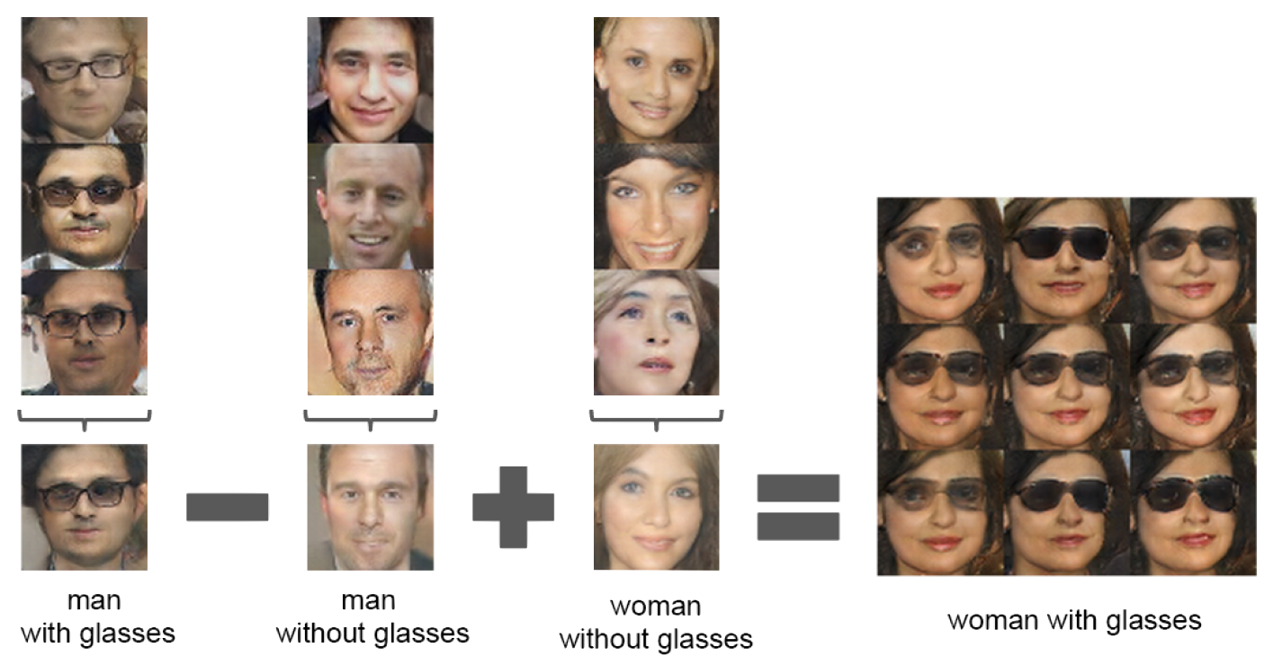
Latent vectors capture interesting patterns…
Notes:
Apart from the visually appearing nature of the images generated by DCGANs, the authors noted another interesting pattern.
i.e. latent vectors support arithmetic over images .. i.e.
if you take the latent vector for a man with glasses,
and subtract that of a man without glasses,
and then add that of a woman without glasses
You get a woman with glasses.
So, we’ll see some more cool things in the later parts of the presentation.

Slide 22
Part 2
Advantages of GANs
Training Challenges
  Non-Convergence
  Mode-Collapse
Proposed Solutions
  Supervision with Labels
  Mini-Batch GANs
Modification of GAN’s losses
  Discriminator (EB-GAN)
  Generator (InfoGAN)
Notes:
In the next 20 mins., we’ll look at
-- the advantages of GANs over other models
-- some Training challenges in GANs
-- some proposed solutions to counter those challenges
-- and, some modifications of basic GAN’s loss to be able to do some cool stuff
-- we’ll look at modifications for both the Discriminator and Generator

Slide 23
Advantages of GANs
Plenty of existing work on Deep Generative Models
  Boltzmann Machine
  Deep Belief Nets
  Variational AutoEncoders (VAE)
Why GANs?
  Sampling (or generation) is straightforward.
  Training doesn't involve Maximum Likelihood estimation.
  Robust to Overfitting since Generator never sees the training data.
  Empirically, GANs are good at capturing the modes of the distribution.
Notes:
-- As Binglin mentioned GANs belong to the general class of Deep Generative Models. However, there plenty of existing work [..]
-- Boltzmann machine and Deep Belief Nets were popular in the last century or the early 2000..
-- However, currently GANs and VAEs are the most popular approaches.. You’re learning about GANs today, and VAEs is the topic of the next class.
-- So, why use GANs over other models?
-- With GANs sampling or generating a new image is straightforward .. You just sample your noise vector and propagate it through the Generator network.
-- To generate n samples, you just have to do this process n times
-- However, other models usually use MCMC Sampling … which is much more expensive... For instance, even to get 1 sample from those networks, you might have to multiple passes.
-- Secondly, other models usually train by optimizing MLE, either directly when it is tractable, or indirectly by constructing a lower bound to it when it is intractable.
-- Whereas Training in GANs involves Sampling which as we saw in the previous bullet is inexpensive..
-- However, it might introduce its own new set of challenges, which we’ll see soon..
-- Thirdly, it is conjectured that GANs might be robust to Overfitting since the generator never sees the real training data, but only the output of the discriminator on its own generated
samples.
-- And lastly, because GANs have been empirically shown to generate sharper images as compared to the other Deep Generative Models

Slide 24
Problems with GANs
Probability Distribution is Implicit
  Not straightforward to compute P(X).
  Thus Vanilla GANs are only good for Sampling/Generation.
Training is Hard
  Non-Convergence
  Mode-Collapse
Notes:
[..] This is not as such a problem with GANs, but more of a design choice.. Thus people are working on hybrid of GANs and VAEs now… which we’ll probably see in the next lecture
-- A part of the reason why we discussed DC-GAN and why it became so popular is because as it turns out, it’s is not easy to train GANs
-- DC-GAN architecture was one of the first architectures that could train GANs to generate good images.
-- So, when you’ll start reading GAN papers, you’ll see that people directly borough DC-GAN’s generator, even though it’s not very well understood as to why it works well.
-- So, to be specific, GANs have two major training challenges :-
-- Non-Convergence
-- Mode-Collapse

Slide 25
Training Problems
Non-Convergence
Mode-Collapse
Notes:
Let’s look at Non-Convergence first..

Slide 26
Deep Learning models (in general) involve a single player
  The player tries to maximize its reward (minimize its loss).
  Use SGD (with Backpropagation) to find the optimal parameters.
  SGD has convergence guarantees (under certain conditions).
  Problem: With non-convexity, we might converge to local optima.
  $\min_{G}{L\left(G\right)}$
GANs instead involve two (or more) players
  Discriminator is trying to maximize its reward.
  Generator is trying to minimize Discriminator’s reward.
  SGD was not designed to find the Nash equilibrium of a game.
  Problem: We might not converge to the Nash equilibrium at all.
$$\min_{G}{\max_{D}{V\left(D, G\right)}}$$
Notes:
Having seen an example of Non-Convergence, let’s see why this might be happening…
[..]
--So, what kind of convergences guarantees do we really have?

Slide 27

Non-Convergence
$\min_{x}{\max_{y}{ V\left(x, y\right)}}$
Let $V\left(x, y\right)=xy$
  State 1:
  State 2:
  State 3:
  State 4 :
  State 5: == State 1
x > 0 | y > 0 | V > 0
Increase y | Decrease x
x < 0 | y > 0 | V < 0
Decrease y | Decrease x
x < 0 | y < 0 | V > 0
Decrease y | Increase x
x > 0 | y < 0 | V < 0
Increase y | Increase x
x > 0 | y > 0 | V > 0
Increase y | Decrease x
Notes:
For very few values of hyper-parameters, it might lead to damped oscillations, but not in general .. which is contrary to Backprop where if you’ll let the program run long enough with decaying step size, it will converge

Slide 28
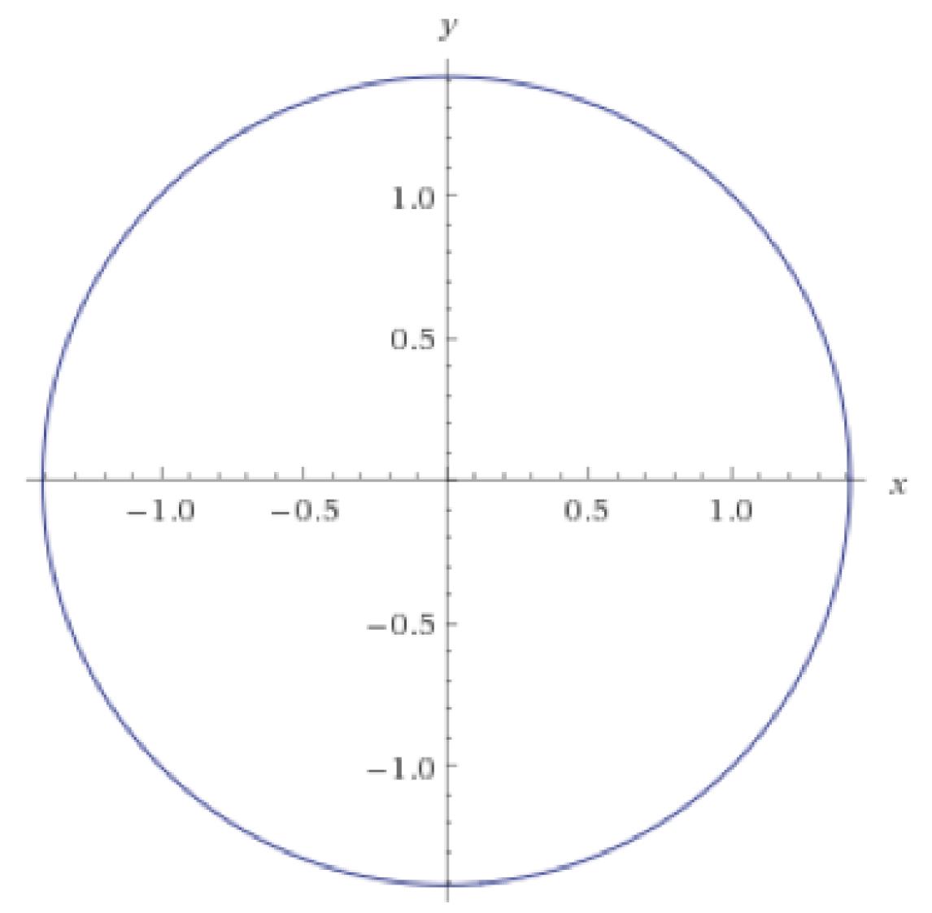
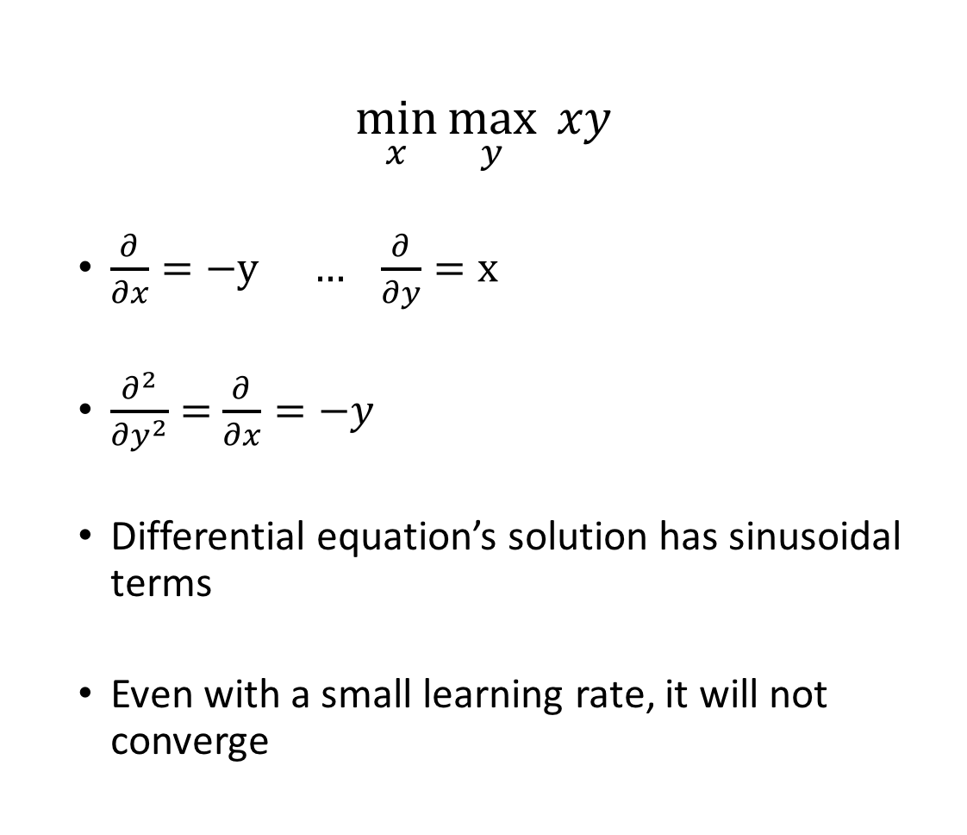
Non-Convergence
$$\min_{x}{\max_{y}{ xy}}$$
  $\frac{∂}{∂x}=−y … \frac{∂}{∂y}=x$
  $\frac{∂^{2}}{∂y^{2}}=$ $\frac{∂}{∂x}=−y$
  Differential equation’s solution has sinusoidal terms
  Even with a small learning rate, it will not converge
Notes:
For very few values of hyper-parameters, it might lead to damped oscillations, but not in general .. which is contrary to Backprop where if you’ll let the program run long enough with decaying step size, it will converge

Slide 29
Problems with GANs
Non-Convergence
Mode-Collapse
Notes:
Having seen the convergence problems, let’s look at the next challenge of Mode-Collapse.

Slide 30
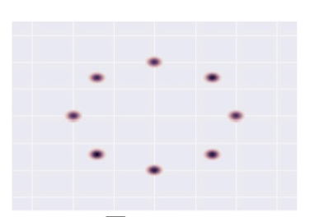
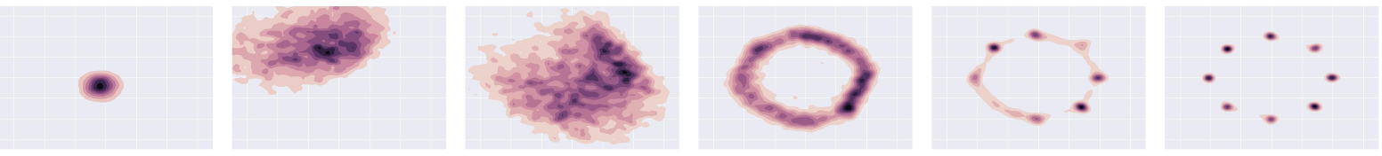
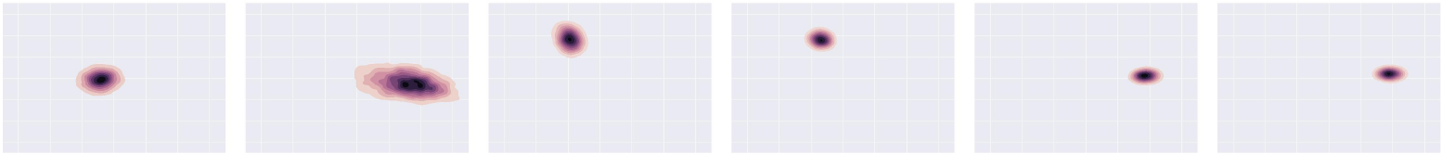
Mode-Collapse
Generator fails to output diverse samples
Target
Expected
Output
Notes:
[..]
-- For instance, given that your real examples are generated from this 2D Gaussian Distribution (with 8 modes), you would expect your generated distribution to follow this trajectory
-- However, in practice, this happens.. i.e. your generated samples move from one mode to another, and fail to capture all the modes .. Thus, you don’t get diversity in the generated samples

Slide 31
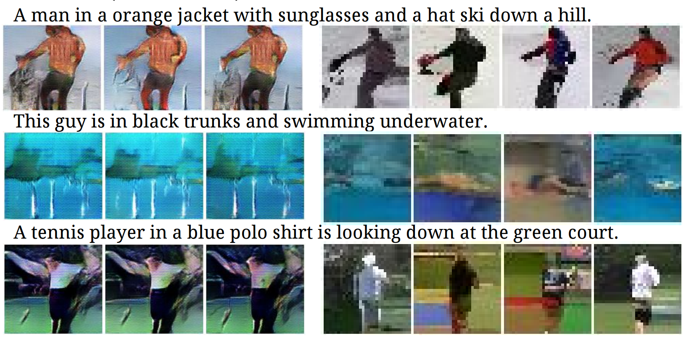
Some real examples
Notes:
-- Let’s look at some real images where this phenomena happens.

Slide 32
Some Solutions
Mini-Batch GANs
Supervision with labels
Some recent attempts :-
  Unrolled GANs
  W-GANs
Notes:
-- So, Mode-Collapse and Non-Convergence are some of the most active research areas in GANs
– Until the end of the last year it wasn’t well understood as to why Mode-Collapse happens… and thus, most of the proposed solutions were pure heuristics… we’ll briefly look at Mini-Batch GANs as one heuristic that sort of make sense and is worth discussing
-- This year, in the late January, there have been several attempts at explaining Mode-Collapse and coming with principled solutions to address it..
However, given the extremely theoretical nature of those papers, they will not be of general interest, thus we recommend people to go back and have a look at them.
-- We’ll however very briefly look at the basic idea of one of such paper .. Unrolled GAN
-- And then we’ll move on to some cool things..

Slide 33
Basic (Heuristic) Solutions
Mini-Batch GANs
Supervision with labels
Notes:
Let’s look at the first heuristic of Mini-Batch GANs

Slide 34
How to reward sample diversity?
At Mode Collapse,
  Generator produces good samples, but a very few of them.
  Thus, Discriminator can’t tag them as fake.
To address this problem,
  Let the Discriminator know about this edge-case.
More formally,
  Let the Discriminator look at the entire batch instead of single examples
  If there is lack of diversity, it will mark the examples as fake
Thus,
  Generator will be forced to produce diverse samples.
Notes:
-- So intuitively, when mode collapse happens .. Our generator is still producing good samples .. But a very few number of them
-- And thus, the Discriminator can’t do anything about it since the fake samples are still realistic.
-- So, if we want to tackle this problem, one way to do that is to let the Discriminator know about this edge-case, so that when it sees it happening, it can mark those samples as fake.
-- To be more formal, let the Discriminator look at the entire batch of generated samples instead of a single example, so that if it sees lack of diversity, it can assign fake labels to the entire batch.
-- Thus, to fool the Discriminator, your Generator will be forced to generate diverse samples.

Slide 35
Mini-Batch GANs
Extract features that capture diversity in the mini-batch
  For e.g. L2 norm of the difference between all pairs from the batch
Feed those features to the discriminator along with the image
Feature values will differ b/w diverse and non-diverse batches
  Thus, Discriminator will rely on those features for classification
This in turn,
  Will force the Generator to match those feature values with the real data
  Will generate diverse batches
Notes:
-- So, that’s the underlying idea, however, in practice, we just mine some features from the batch that capture the diversity .. For instance L2 norm of the distance between pair of samples .. And feed those features to the discriminator along with the image.
-- Since, the real dataset will have diversity.. These features will have a different value as compared to the values for a non-diverse fake batch .. Thus Discriminator will be able to identify the fake samples … which in turn will force the Generator to produce diverse samples

Slide 36
Basic (Heuristic) Solutions
Mini-Batch GANs
Supervision with labels
Notes:
Let’s look at the second heuristic of supervising with labels

Slide 37
Supervision with Labels
Label information of the real data might help
Empirically generates much better samples
Car
Dog
Real
D
D
Human
Fake
Fake
Notes:
A purely heuristic method – there is no understanding as to why this method works…
The idea is very simple i.e. instead of having a binary classification problem of Fake vs Real in the Discriminator .. You replace it with a Multi-class classification problem where K classes are for the K labels in the dataset, and the K+1th class is for the fake image.
And correspondingly modify the cross-entropy loss .. So the new cross entropy loss now will contain K+1 terms.

Slide 38

Alternate view of GANs
$$\min_{G}{\max_{D}{V\left(D, G\right)}}$$
$$V\left(D, G\right)=𝔼_{x∼p(x)}\left[\log{D\left(x\right)}\right]+𝔼_{z∼q(z)}\left[\log\left(1−D\left(G(z)\right)\right)\right]$$
$$D^{∗}{= arg\max_{D}{V\left(D, G\right)} G^{∗}= }arg\min_{G}{V\left(D, G\right)}$$
In this formulation, Discriminator’s strategy was $D\left(x\right)→1, D\left(G\left(z\right)\right)→0$
Alternatively, we can flip the binary classification labels i.e. Fake = 1, Real = 0
  $$V\left(D, G\right)=𝔼_{x∼p(x)}\left[log\left(1 −D\left(x\right)\right)\right]+𝔼_{z∼q(z)}\left[\log\left(D\left(G(z)\right)\right)\right]$$
In this new formulation, Discriminator’s strategy will be $D\left(x\right)→0, D\left(G\left(z\right)\right)→1$
Notes:
<<Insert Conditions on such a Energy Function>>
This kind of loss function can be generalized by having the discriminator as an Energy function that assigns high energy to fake samples and low energy to real samples.
Outputting probabilities require

Slide 39
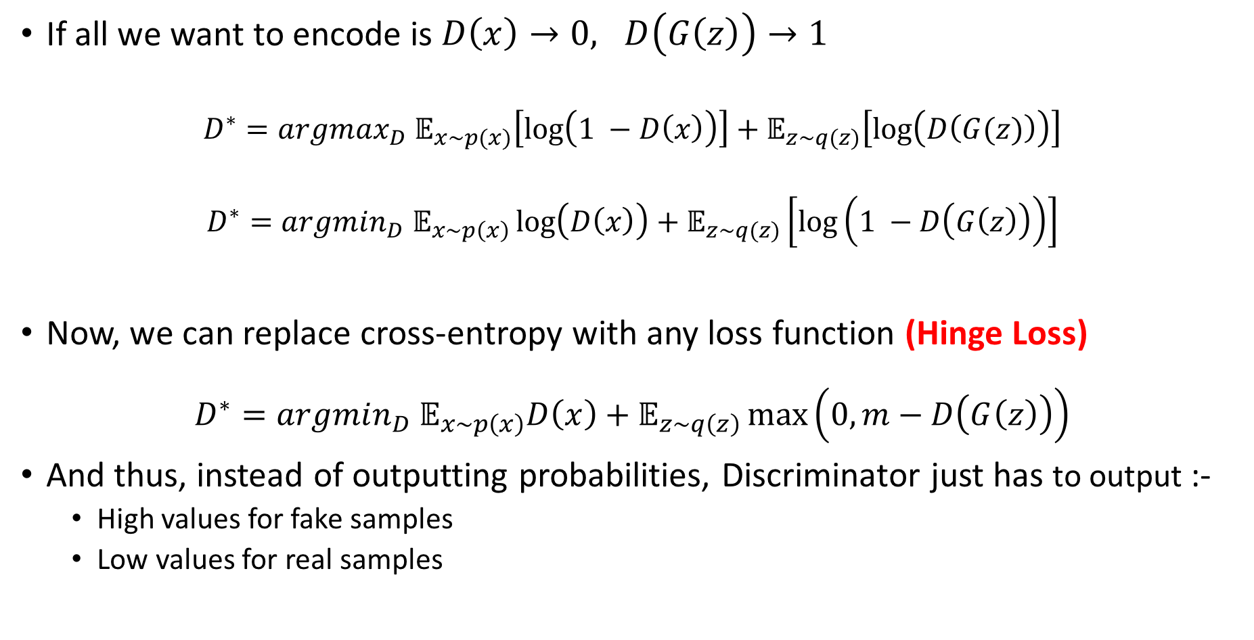
Alternate view of GANs (Contd.)
If all we want to encode is $D\left(x\right)→0, D\left(G\left(z\right)\right)→1$
  $$D^{∗}={argmax_{D} 𝔼}_{x∼p(x)}\left[log\left(1 −D\left(x\right)\right)\right]+𝔼_{z∼q(z)}\left[\log\left(D\left(G(z)\right)\right)\right]$$
  $$D^{∗}={argmin_{D} 𝔼}_{x∼p\left(x\right)}\log\left(D\left(x\right)\right)+𝔼_{z∼q(z)}\left[\log\left(1 −D\left(G\left(z\right)\right)\right)\right]$$
Now, we can replace cross-entropy with any loss function (Hinge Loss)
$${D^{∗}=argmin_{D} 𝔼}_{x∼p\left(x\right)}D\left(x\right)+𝔼_{z∼q\left(z\right)}\max\left(0, m−D\left(G\left(z\right)\right)\right)$$
And thus, instead of outputting probabilities, Discriminator just has to output :-
  High values for fake samples
  Low values for real samples
We can use this
Notes:
<<Insert Conditions on such a Energy Function>>
This kind of loss function can be generalized by having the discriminator as an Energy function that assigns high energy to fake samples and low energy to real samples.
Outputting probabilities require

Slide 40
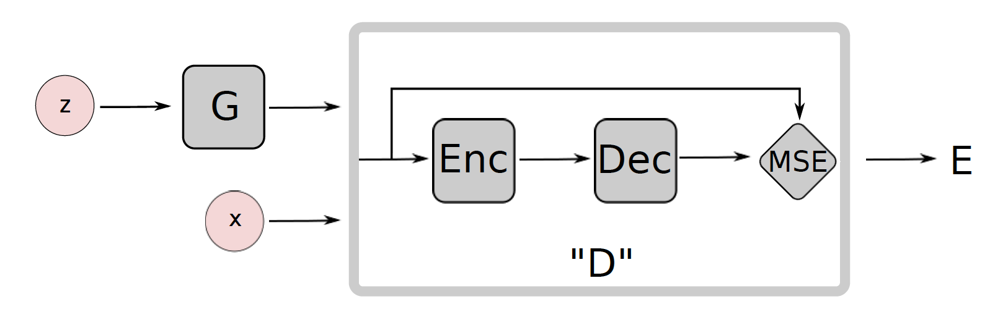
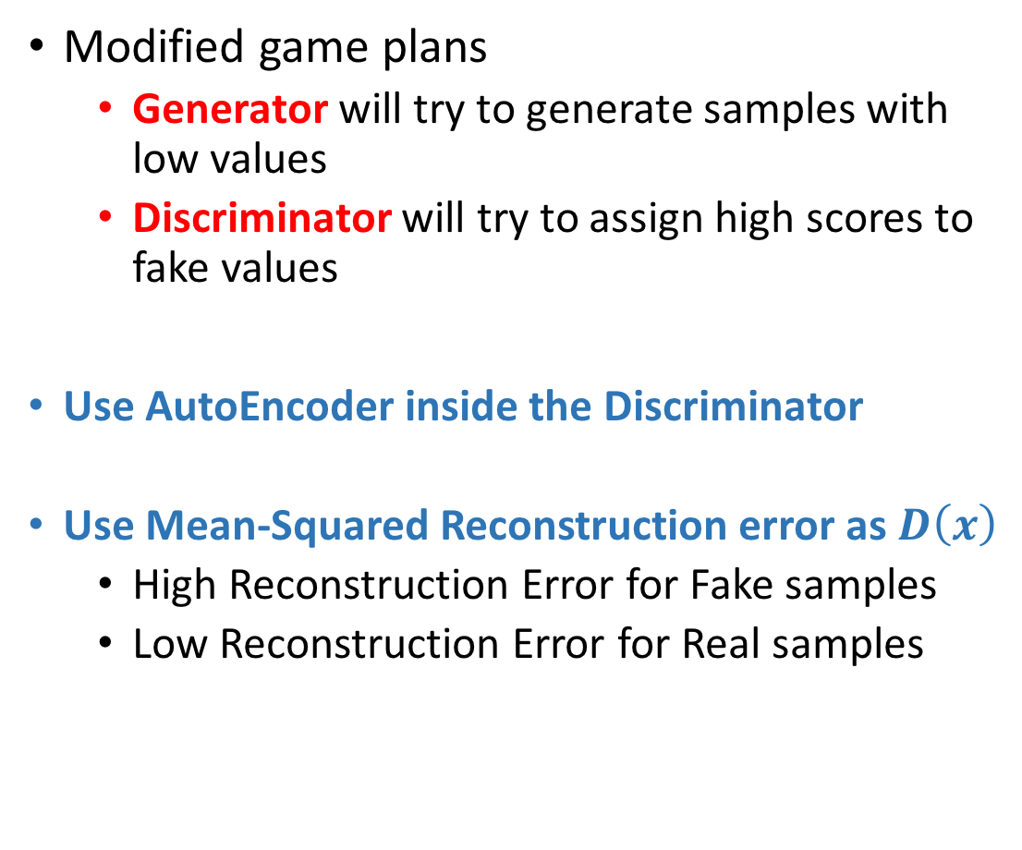
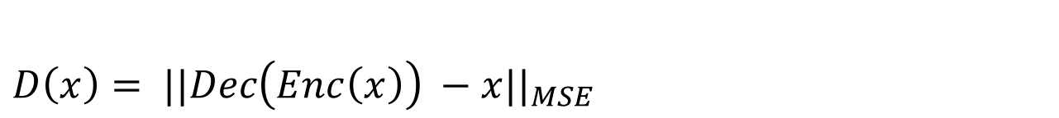
Energy-Based GANs
Modified game plans
  Generator will try to generate samples with low values
  Discriminator will try to assign high scores to fake values
Use AutoEncoder inside the Discriminator
Use Mean-Squared Reconstruction error as $D\left(x\right)$
  High Reconstruction Error for Fake samples
  Low Reconstruction Error for Real samples
$$D\left(x\right)= ||Dec\left(Enc\left(x\right)\right) −x||_{MSE}$$
Notes:
<<Some thoughts on the changes in the training algo. here>>
<<Also, include some results from the paper i.e. what did this objective achieve>>
<<Some people have also tried Denoising AutoEncoders>>

Slide 41
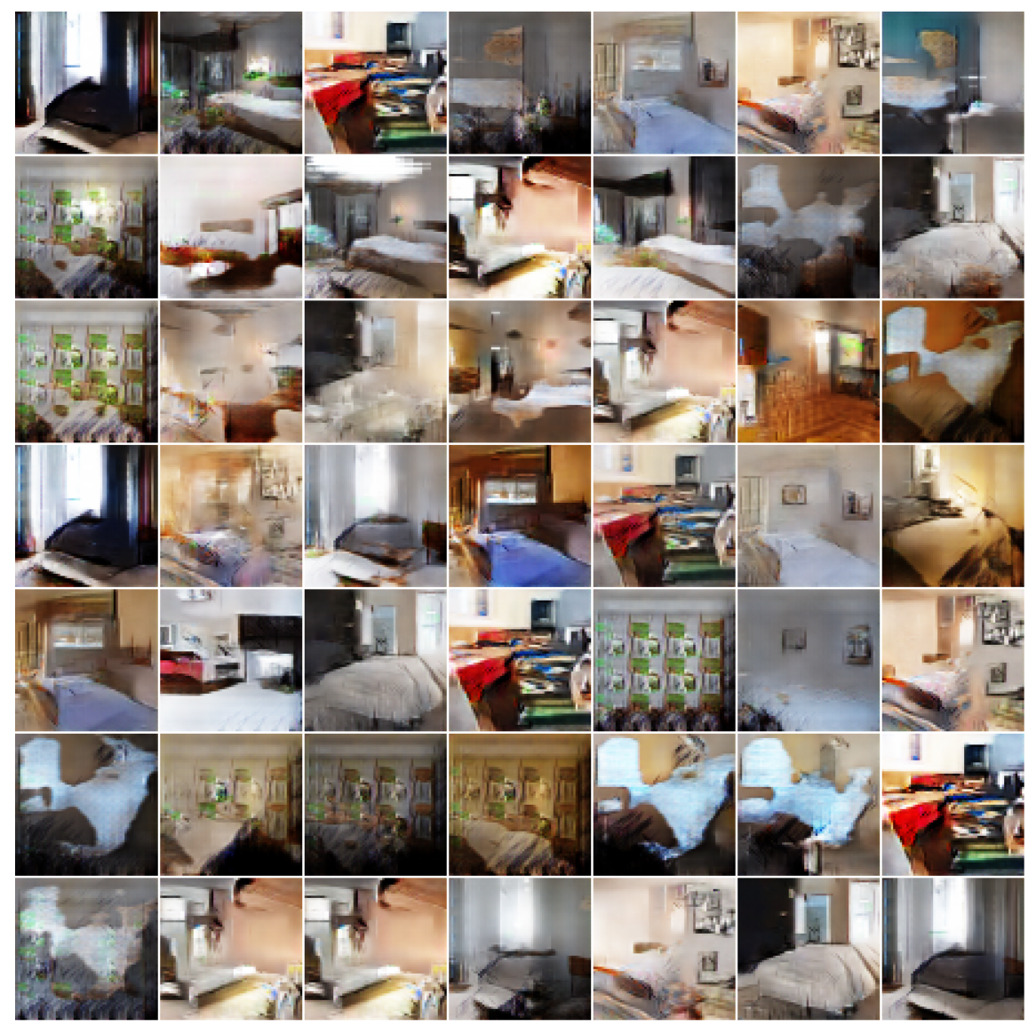
More Bedrooms…
Notes:
Like DC-GAN .. EB-GANs are able to generate good high resolution images

Slide 42
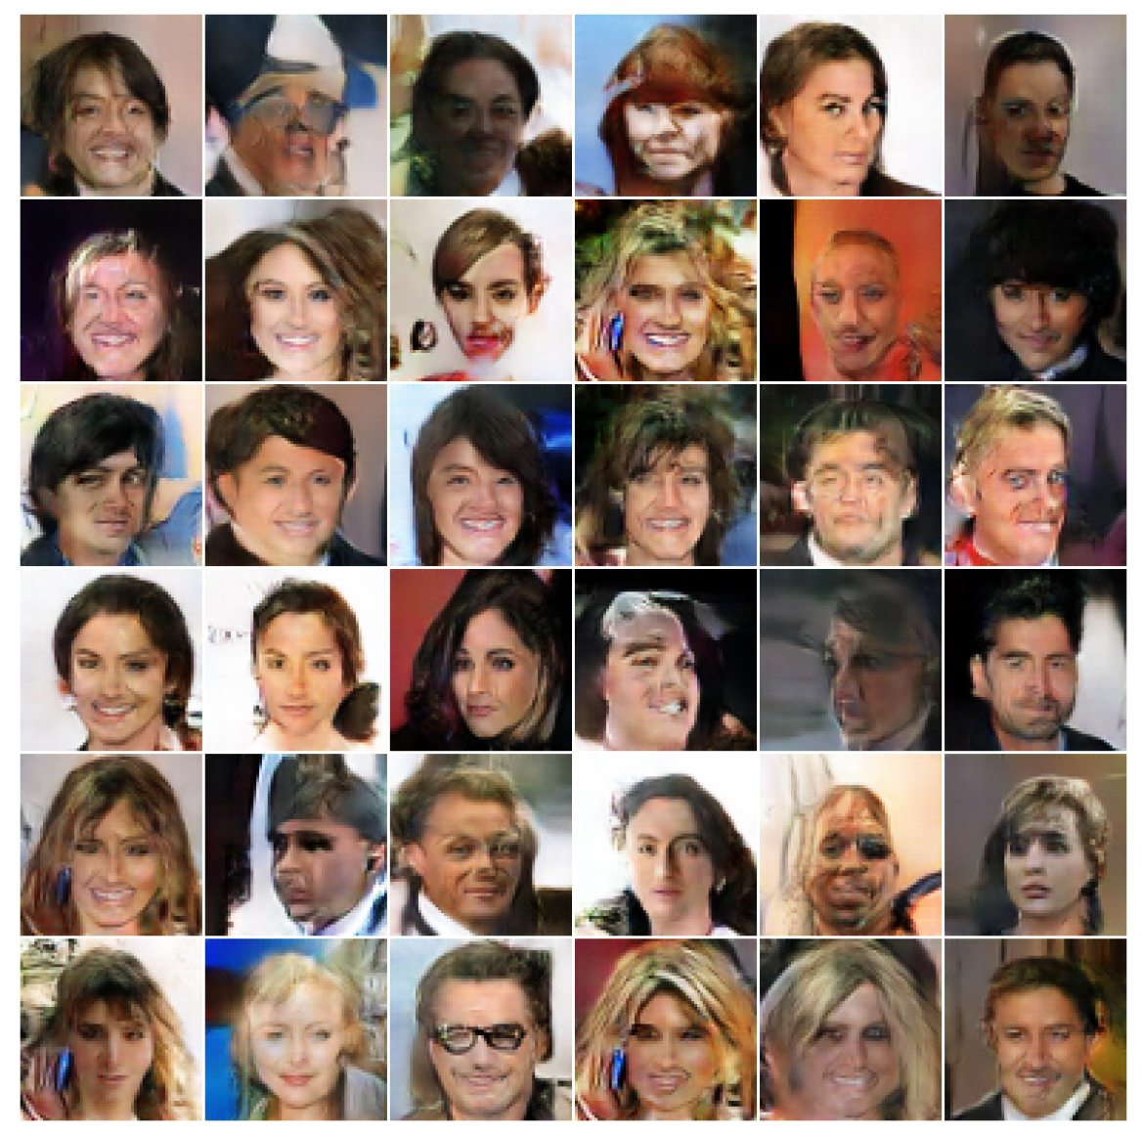
Celebs…
Notes:
They also do a good job at generating ugly celebrities..

Slide 43
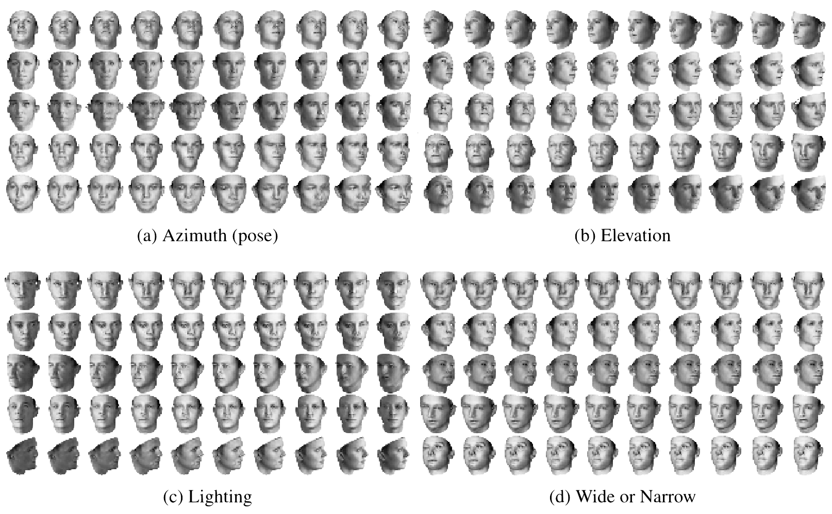
The Cool Stuff…
3D Faces
Notes:
-- So, training GANs is tricky, but when they do work, they can do some really cool stuff.. I’ll cover one such cool application, and then Bhargav will go over the rest
-- So, until now we just said that, if you want to generate an image from GANs, sample from a noise distribution, and propagate it through the network.. However, we had no control over what we’ll end up generating
-- Won’t it be cool, if by changing just one dimension in the noise vector, we can control some aspect of the image
-- For instance, let’s say with one initialization of the z vector, I get the first image, now if by changing just one dimension of the z vector,
I can make my image to change the pose, it would be pretty cool.. So, in that case, that particular dimension will be handling the pose
of the image.
-- Similarly, a second z dimension can cover the Elevation of the image, a third z dimension can cover the Lighting and the fourth, the
width of the image.
-- Note that, you’ll most likely never find so many poses of the same person in your training set, however, your generator has learnt to control these aspects by looking at different poses of different people.
-- So, this is pretty cool… Just imagine how much robust your standard training can become by looking at all these additional examples

Slide 44
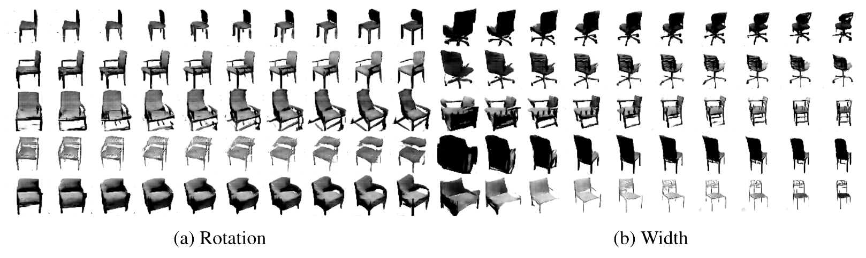
Cool Stuff (contd.)
3D Chairs
Notes:
This is another example…
-- So, some of you might be able to relate it to DCGANs, in which subtraction and addition of images was meaningful (even though there was nothing in the objective that was enforcing it), thus such patterns were sort of distributed across multiple z dimensions...
-- But what we want here is to be able to enforce this requirement in the objective so that we can get such disentagled dimensions where one dimension covers one aspect of the image.
-- That’s what InfoGANs were designed to accomplish.

Slide 45
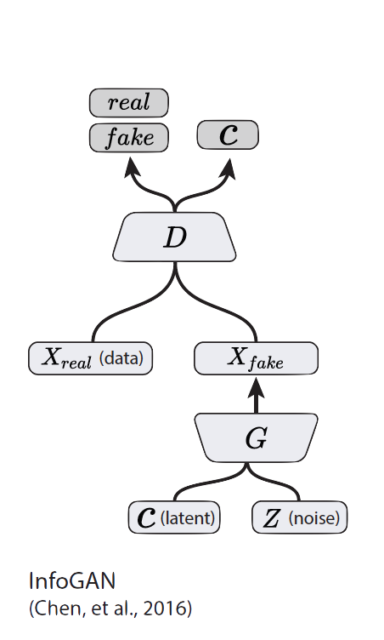
How to reward Disentanglement?
Disentanglement means individual dimensions independently capturing key attributes of the image
Let’s partition the noise vector into 2 parts :-
  z vector will capture slight variations in the image
  c vector will capture the main attributes of the image
    For e.g. Digit, Angle and Thickness of images in MNIST
If c vector captures the key variations in the image,
Will c and $x_{fake}$ be highly correlated or weakly correlated?

Slide 46
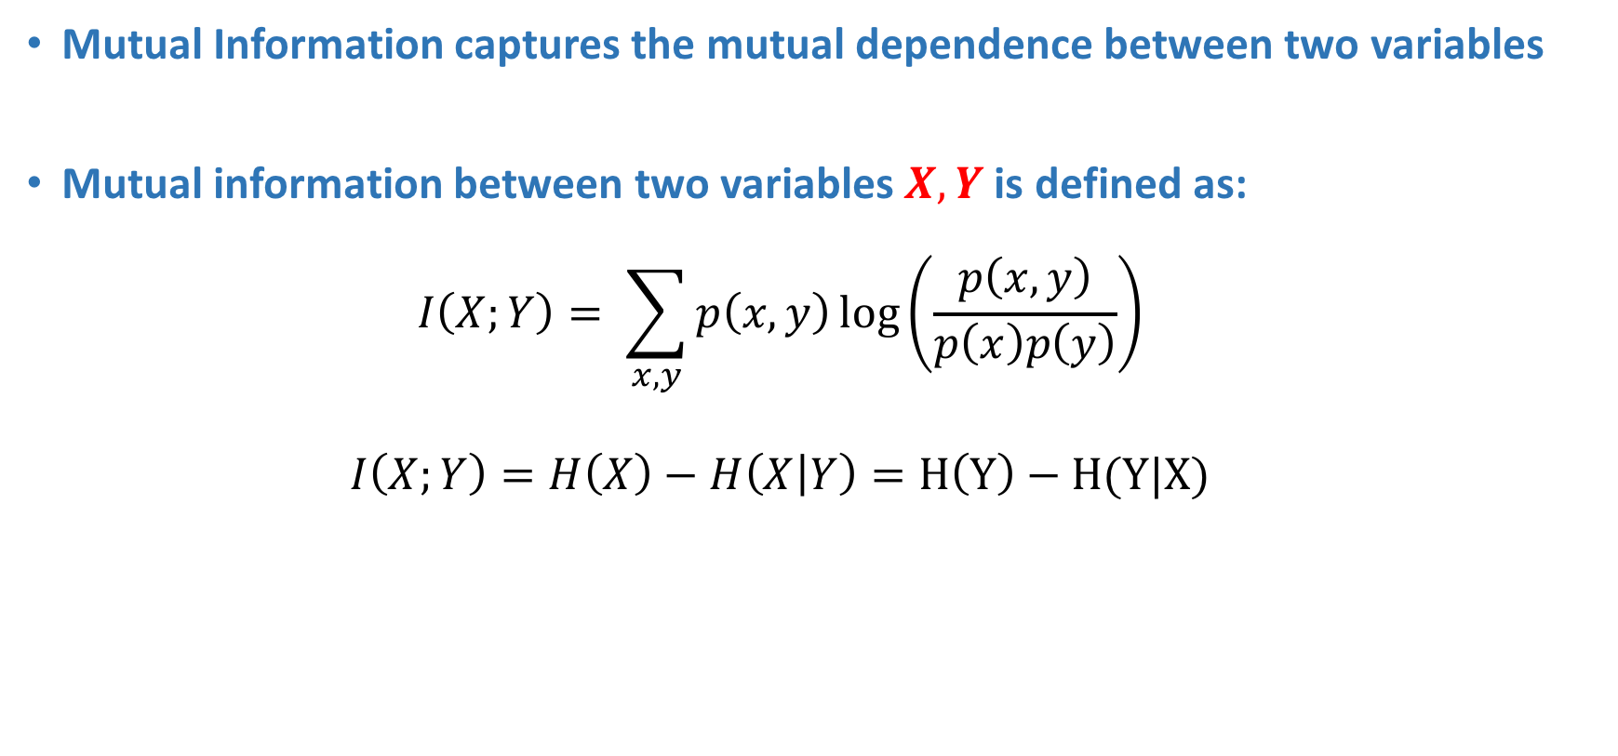
Recap: Mutual Information
Mutual Information captures the mutual dependence between two variables
Mutual information between two variables $X, Y$ is defined as:
  $$I\left(X;Y\right)= \sum_{x,y}{p\left(x,y\right)\log\left(\frac{p\left(x,y\right)}{p\left(x\right)p\left(y\right)}\right)}$$
  $$I\left(X;Y\right)=H\left(X\right)−H\left(X | Y\right)=H\left(Y\right)−H(Y|X)$$

Slide 47
InfoGAN
We want to maximize the mutual information $I$ between $c$ and $x=G(z,c)$
Incorporate in the value function of the minimax game.
$$\min_{G}{\max_{D}{V_{I}\left(D,G\right)=V\left(D,G\right) −λ I\left(c;G\left(z,c\right)\right)}}$$

Slide 48
InfoGAN
Mutual Information’s Variational Lower bound
$$I\left(c;G\left(z,c\right)\right)=H\left(c\right)−H\left(c | G\left(z,c\right)\right)$$
$$= 𝔼_{x \sim G\left(z,c\right)}\left[𝔼_{c^{′}\sim P\left(c | x\right)}\left[\log{P\left(c^{′} | x\right)}\right]\right]+H(c)$$
$$= 𝔼_{x \sim G\left(z,c\right)}\left[{D_{KL}(P|\left|Q\right)+ 𝔼}_{c^{′}\sim P\left(c | x\right)}\left[\log{Q\left(c^{′} | x\right)}\right]\right]+H(c)$$
$$≥𝔼_{x \sim G\left(z,c\right)}\left[{ 𝔼}_{c^{′}\sim P\left(c | x\right)}\left[\log{Q\left(c^{′} | x\right)}\right]\right]+H(c)$$
$$≥𝔼_{c\sim P\left(c\right), x \sim G\left(z,c\right)}\left[\log{Q(c|x)}\right]+H(c)$$
$$D$$
$$Q$$
Notes:
Posterior like term

Slide 49
Part 3
Conditional GANs
Applications
  Image-to-Image Translation
  Text-to-Image Synthesis
  Face Aging
Advanced GAN Extensions
  Coupled GAN
  LAPGAN – Laplacian Pyramid of Adversarial Networks
  Adversarially Learned Inference
Summary
Notes:
Quick Recap here.

Slide 50
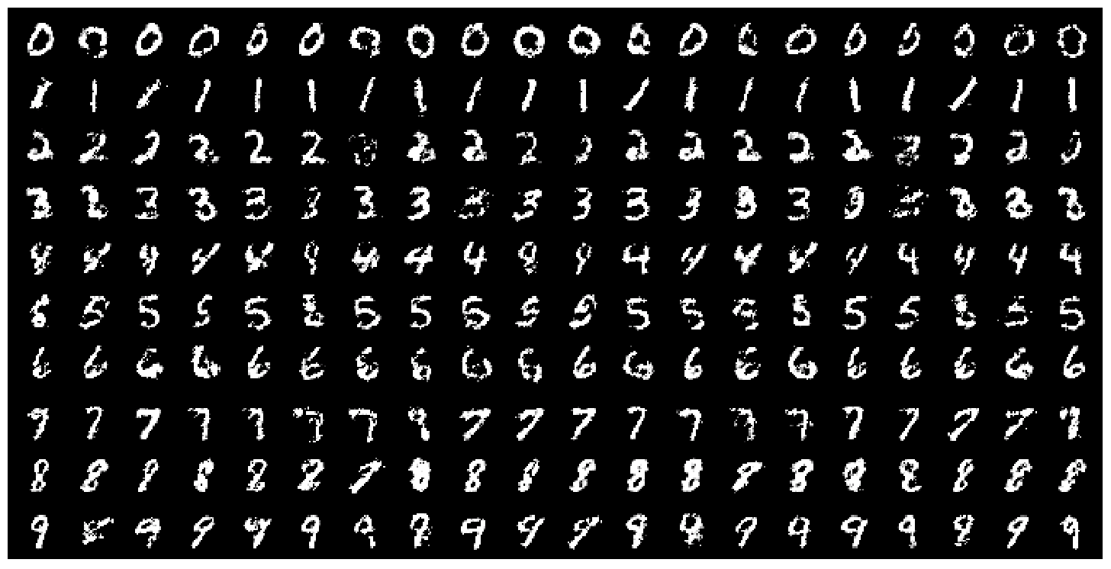
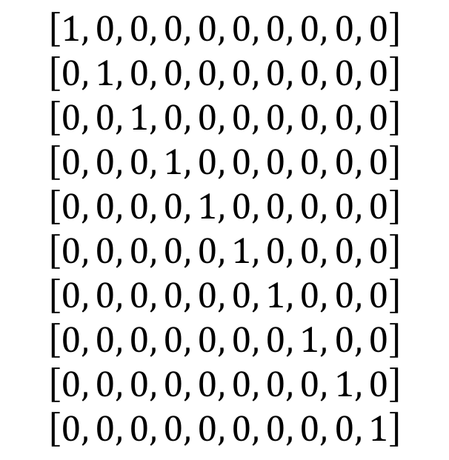
Conditional GANs
MNIST digits
generated conditioned on their class label.
$$\left[1, 0, 0, 0, 0, 0, 0, 0, 0, 0\right]$$
$$\left[0, 1, 0, 0, 0, 0, 0, 0, 0, 0\right]$$
$$\left[0, 0, 1, 0, 0, 0, 0, 0, 0, 0\right]$$
$$\left[0, 0, 0, 1, 0, 0, 0, 0, 0, 0\right]$$
$$\left[0, 0, 0, 0, 1, 0, 0, 0, 0, 0\right]$$
$$\left[0, 0, 0, 0, 0, 1, 0, 0, 0, 0\right]$$
$$\left[0, 0, 0, 0, 0, 0, 1, 0, 0, 0\right]$$
$$\left[0, 0, 0, 0, 0, 0, 0, 1, 0, 0\right]$$
$$\left[0, 0, 0, 0, 0, 0, 0, 0, 1, 0\right]$$
$$\left[0, 0, 0, 0, 0, 0, 0, 0, 0, 1\right]$$
MNIST digits
Figure 2 in the original paper.
Notes:
Does not have to be class labels. We can condition on any explicit supervision available.

Slide 51
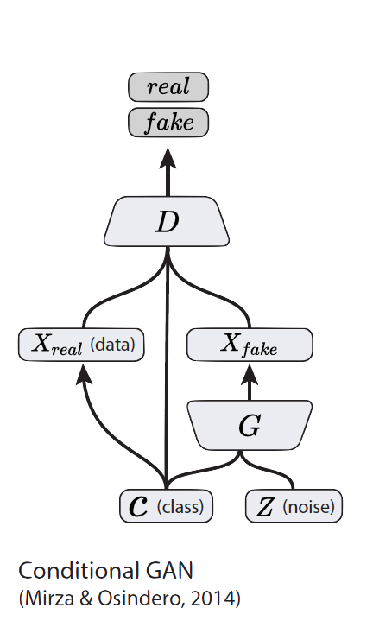
Conditional GANs
Simple modification to the original GAN framework that conditions the model on additional information for better multi-modal learning.
Lends to many practical applications of GANs when we have explicit supervision available.
Image Credit: Figure 2 in Odena, A., Olah, C. and Shlens, J., 2016. Conditional image synthesis with auxiliary classifier GANs. arXiv preprint arXiv:1610.09585.

Slide 52
Part 3
Conditional GANs
Applications
  Image-to-Image Translation
  Text-to-Image Synthesis
  Face Aging
Advanced GAN Extensions
  Coupled GAN
  LAPGAN – Laplacian Pyramid of Adversarial Networks
  Adversarially Learned Inference
Summary
Notes:
Quick Recap here.

Slide 53
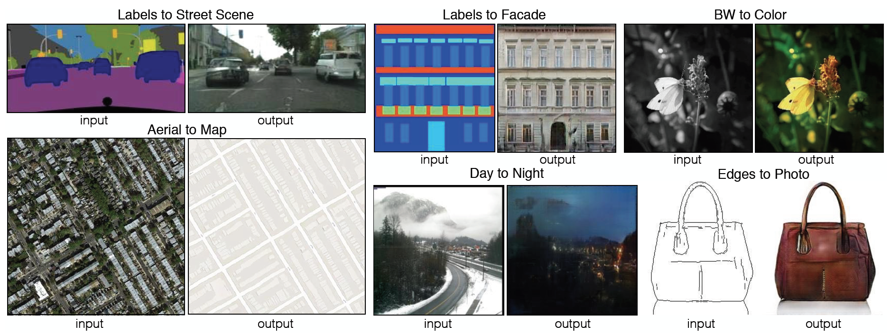
Image-to-Image Translation
Figure 1 in the original paper.
Link to an interactive demo of this paper

Slide 54
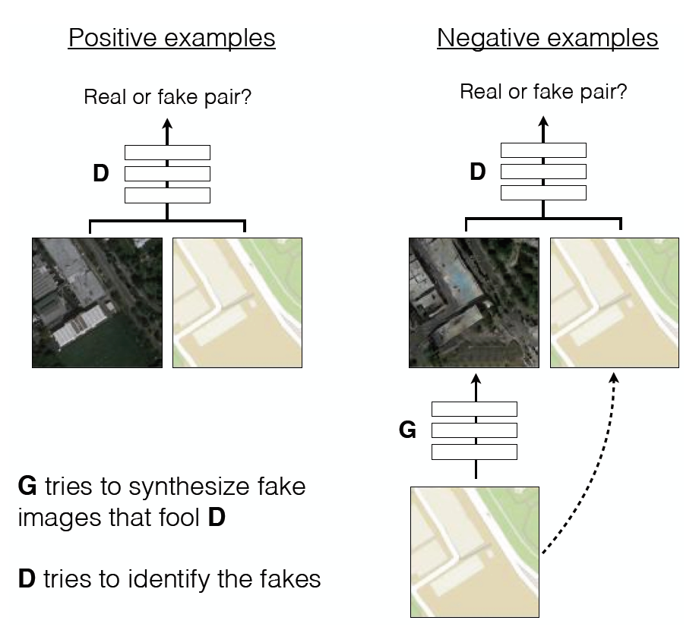
Image-to-Image Translation
Architecture: DCGAN-based architecture
Training is conditioned on the images from the source domain.
Conditional GANs provide an effective way to handle many complex domains without worrying about designing structured loss functions explicitly.
Figure 2 in the original paper.
Notes:
DCGAN shows a set of constraints that work for training GANs and most of the application follow their architecture closely.
No need to design effective loss functions for each domain. GAN gives a “structured loss” for free.

Slide 55
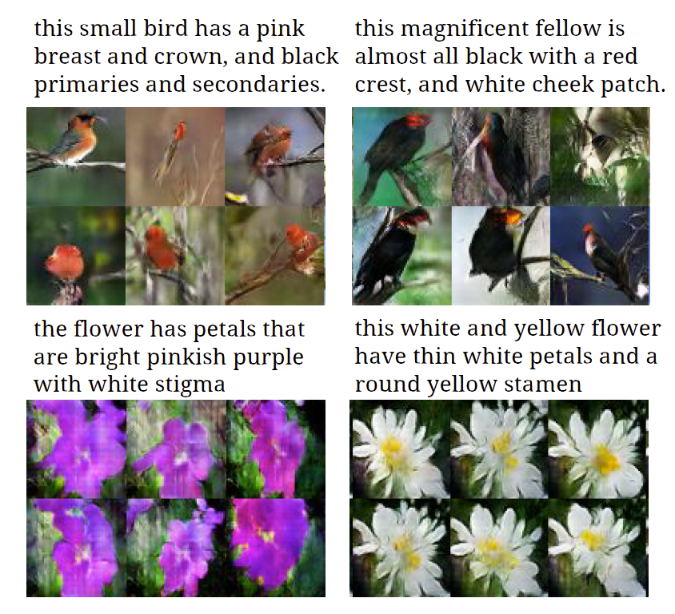
Text-to-Image Synthesis
Motivation
Given a text description, generate images closely associated.
Uses a conditional GAN with the generator and discriminator being condition on “dense” text embedding.
Figure 1 in the original paper.
Notes:
Talk about the diversity of images also.

Slide 56
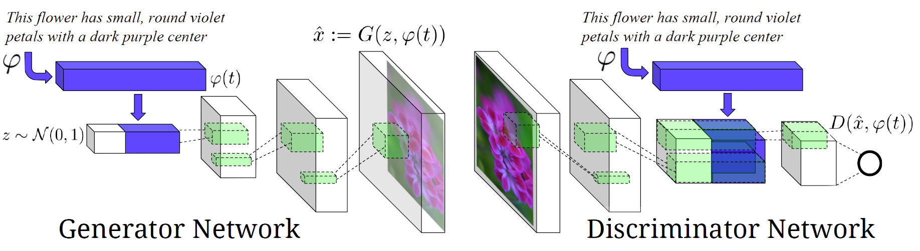
Text-to-Image Synthesis
Figure 2 in the original paper.
Positive Example:
Real Image, Right Text
Negative Examples:
Real Image, Wrong Text
Fake Image, Right Text

Slide 57
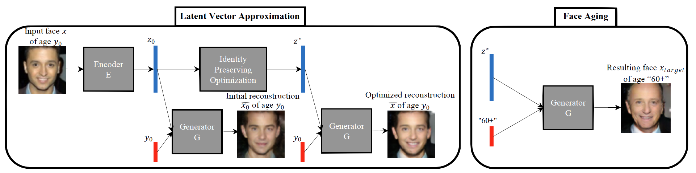
Face Aging with Conditional GANs
Differentiating Feature: Uses an Identity Preservation Optimization using an auxiliary network to get a better approximation of the latent code (z*) for an input image.
Latent code is then conditioned on a discrete (one-hot) embedding of age categories.
Figure 1 in the original paper.

Slide 58
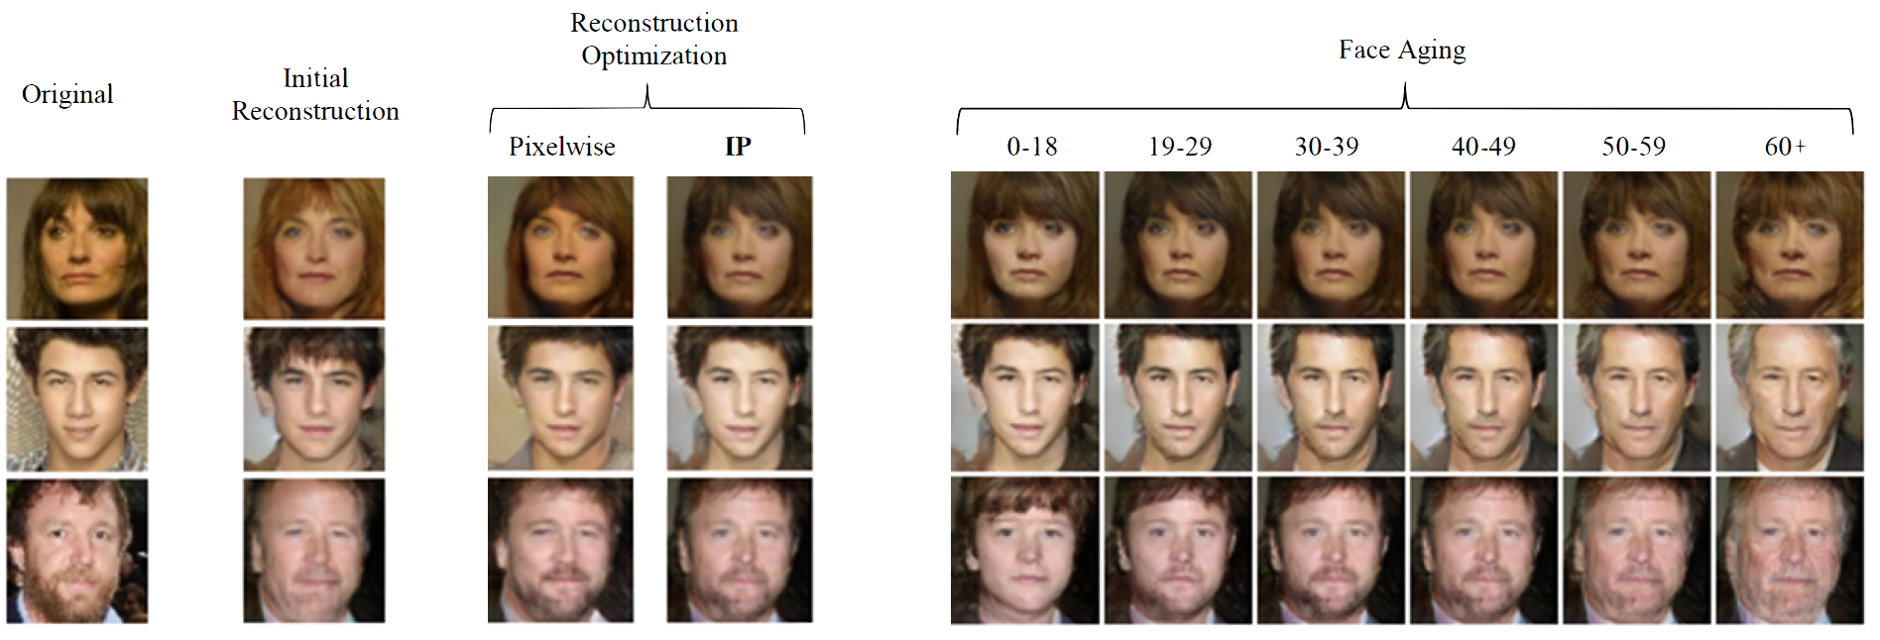
Face Aging with Conditional GANs
Figure 3 in the original paper.

Slide 59

Conditional GANs
Conditional Model Collapse
Scenario observed when the Conditional GAN starts ignoring either the code (c) or the noise variables (z).
This limits the diversity of images generated.
Credit?
Notes:
Explain this + Briefly talk about how to address this?

Slide 60
Part 3
Conditional GANs
Applications
  Image-to-Image Translation
  Text-to-Image Synthesis
  Face Aging
Advanced GAN Extensions
  Coupled GAN
  LAPGAN – Laplacian Pyramid of Adversarial Networks
  Adversarially Learned Inference
Summary

Slide 61
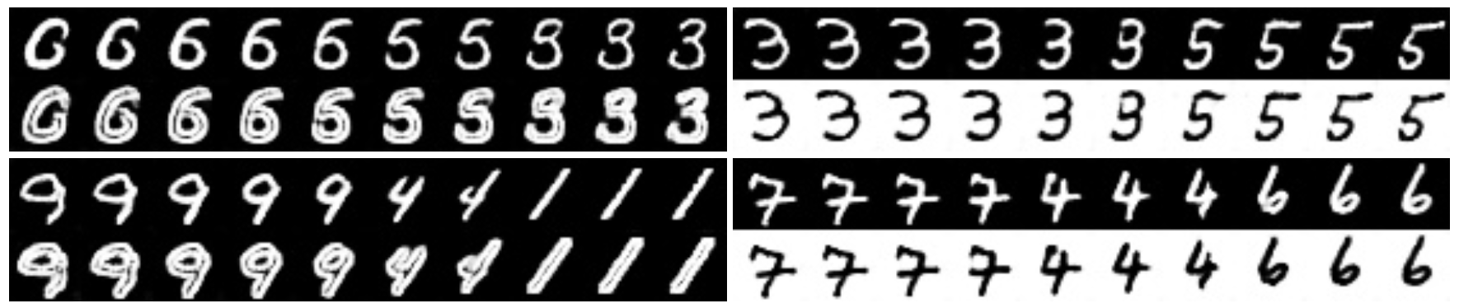
Coupled GAN
Figure 2 in the original paper.
Learning a joint distribution of multi-domain images.
Using GANs to learn the joint distribution with samples drawn from the marginal distributions.
Direct applications in domain adaptation and image translation.
Notes:
We do not need parallel images here.

Slide 62
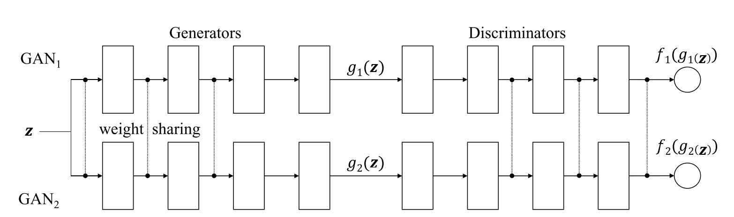
Coupled GANs
Architecture
Figure 1 of the original paper.
Weight-sharing constraints the network to learn a joint distribution without corresponding supervision.
Notes:
Interpretation: Two teams where each team has two players. Collaboration is established from the weight-sharing constraint.
We do not need parallel images here.

Slide 63
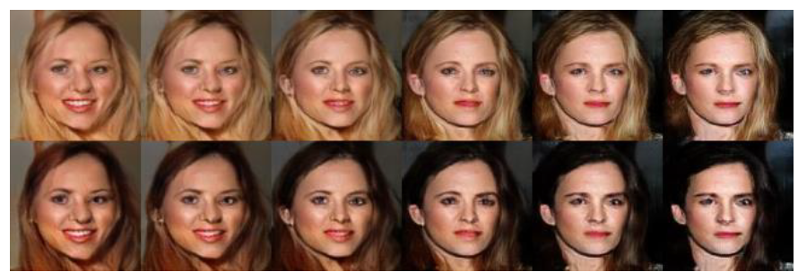
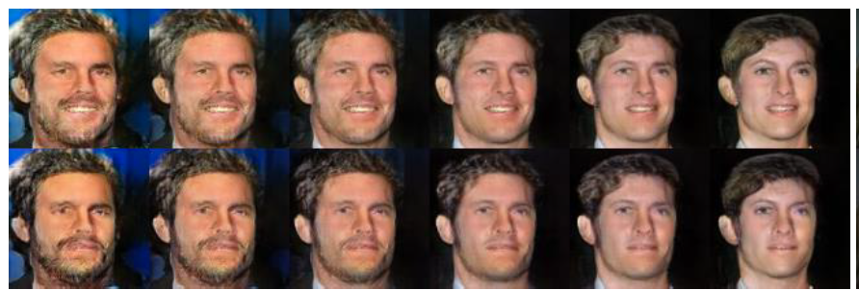
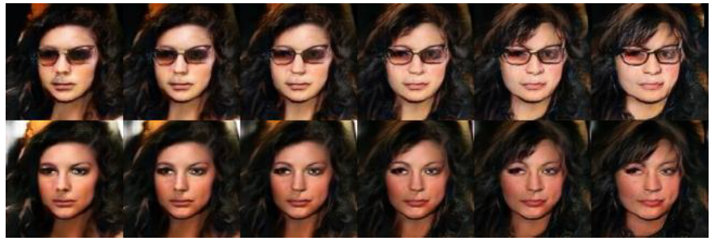
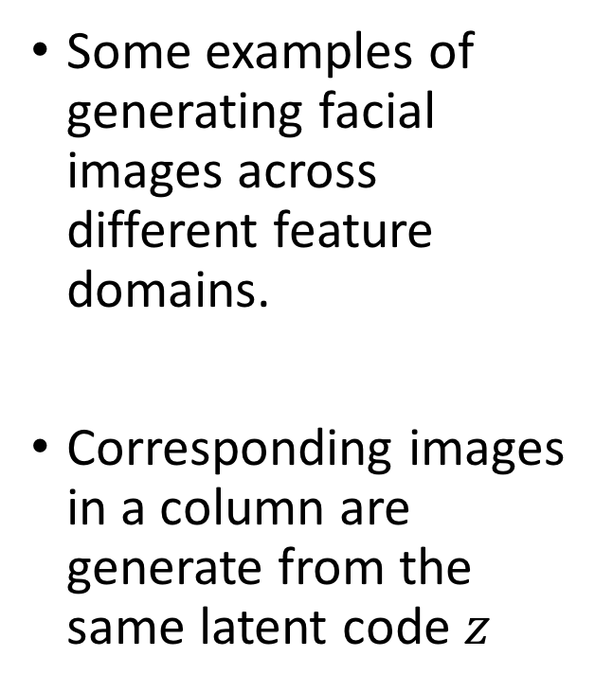
Coupled GANs
Hair Color
Some examples of generating facial images across different feature domains.
Corresponding images in a column are generate from the same latent code $z$
Facial
Expression
Sunglasses
Figure 4 in the original paper.

Slide 64

Laplacian Pyramid of Adversarial Networks
Figure 1 in the original paper. (Edited for simplicity)
Based on the Laplacian Pyramid representation of images. (1983)
Generate high resolution (dimension) images by using a hierarchical system of GANs
Iteratively increase image resolution and quality.
Notes:
So, the Generator generates I3, h2, h1, h0 only.

Slide 65


Laplacian Pyramid of Adversarial Networks
Figure 1 in the original paper.
Image Generation using a LAPGAN
Generator $G_{3}$ generates the base image $\tilde{I_{3}}$ from random noise input $z_{3}$.
Generators ($G_{2},G_{1},G_{0}$) iteratively generate the difference image ($\hat{h})$ conditioned on previous small image ($l$).
This difference image is added to an up-scaled version of previous smaller image.
Notes:
So, the Generator generates I3, h2, h1, h0 only.

Slide 66

Laplacian Pyramid of Adversarial Networks
Figure 2 in the original paper.
Training Procedure:
Models at each level are trained independently to learn the required representation.
Notes:
Red -> Blur and Downscale (by a factor of 2)
Green -> Upsample (by a factor of 2)
Models at each level is trained independently to learn the required representation.

Slide 67

Adversarially Learned Inference
Basic idea is to learn an encoder/inference network along with the generator network.
Consider the following joint distributions over $x$ (image) and $z$ (latent variables) :
$$q\left(x, z\right) = q\left(x\right) q(z|x)$$
$$p\left(x, z\right)= p\left(z\right) p(x|z)$$
encoder distribution
generator distribution

Slide 68

Adversarially Learned Inference
Discriminator Network
Encoder/Inference Network
Generator Network
Figure 1 in the original paper.
$$\min_{G}{\max_{D}{ 𝔼_{q\left(x\right)}[\log\left(D\left(x, G_{z}\left(x\right)\right)\right]+𝔼_{p\left(x\right)}\left[\log\left(1 −D\left(G_{x}\left(z\right), z\right)\right)\right]}}$$

Slide 69

Adversarially Learned Inference
Nash equilibrium yields
  Joint: $p\left(x, z\right) \sim q\left(x,z\right)$
  Marginals: $p\left(x\right) \sim q\left(x\right)$ and $p\left(z\right)\sim q\left(z\right)$
  Conditionals: $p\left(x|z\right) \sim q(x|z)$ and $p\left(z|x\right) \sim q\left(z|x\right)$
Inferred latent representation successfully reconstructed the original image.
Representation was useful in the downstream semi-supervised task.

Slide 70
Summary
GANs are generative models that are implemented using two stochastic neural network modules: Generator and Discriminator.
Generator tries to generate samples from random noise as input
Discriminator tries to distinguish the samples from Generator and samples from the real data distribution.
Both networks are trained adversarially (in tandem) to fool the other component. In this process, both models become better at their respective tasks.

Slide 71
Why use GANs for Generation?
Can be trained using back-propagation for Neural Network based Generator/Discriminator functions.
Sharper images can be generated.
Faster to sample from the model distribution: single forward pass generates a single sample.

Slide 72
Reading List
Goodfellow, I., Pouget-Abadie, J., Mirza, M., Xu, B., Warde-Farley, D., Ozair, S., Courville, A. and Bengio, Y. Generative adversarial nets, NIPS (2014).
Goodfellow, Ian NIPS 2016 Tutorial: Generative Adversarial Networks, NIPS (2016).
Radford, A., Metz, L. and Chintala, S., Unsupervised representation learning with deep convolutional generative adversarial networks. arXiv preprint arXiv:1511.06434. (2015).
Salimans, T., Goodfellow, I., Zaremba, W., Cheung, V., Radford, A., & Chen, X. Improved techniques for training gans. NIPS (2016).
Chen, X., Duan, Y., Houthooft, R., Schulman, J., Sutskever, I., & Abbeel, P. InfoGAN: Interpretable Representation Learning by Information Maximization Generative Adversarial Nets, NIPS (2016).
Zhao, Junbo, Michael Mathieu, and Yann LeCun. Energy-based generative adversarial network. arXiv preprint arXiv:1609.03126 (2016).
Mirza, Mehdi, and Simon Osindero. Conditional generative adversarial nets. arXiv preprint arXiv:1411.1784 (2014).
Liu, Ming-Yu, and Oncel Tuzel. Coupled generative adversarial networks. NIPS (2016).
Denton, E.L., Chintala, S. and Fergus, R., 2015. Deep Generative Image Models using a Laplacian Pyramid of Adversarial Networks. NIPS (2015)
Dumoulin, V., Belghazi, I., Poole, B., Lamb, A., Arjovsky, M., Mastropietro, O., & Courville, A. Adversarially learned inference. arXiv preprint arXiv:1606.00704 (2016).
Applications:
Isola, P., Zhu, J. Y., Zhou, T., & Efros, A. A. Image-to-image translation with conditional adversarial networks. arXiv preprint arXiv:1611.07004. (2016).
Reed, S., Akata, Z., Yan, X., Logeswaran, L., Schiele, B., & Lee, H. Generative adversarial text to image synthesis. JMLR (2016).
Antipov, G., Baccouche, M., & Dugelay, J. L. (2017). Face Aging With Conditional Generative Adversarial Networks. arXiv preprint arXiv:1702.01983.

Slide 73
Questions?

